Slide 1
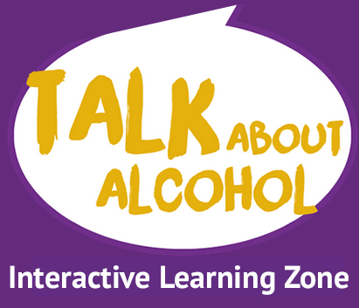
LESSON 1 ASSESSING KNOWLEDGE
How much do you know about alcohol?

Slide 2
GROUND RULES How will we behave in today’s session?
Respect
Listen
No personal info
Not laughed at
Where to get help?
Ask it basket
It’s OK not to know
Confidentiality
OK to pass

Slide 3
SIGNPOSTING where can I get help?
LOCAL HELP
Please add in your local agencies
Please add in your local agencies
NATIONAL HELP
Childline: (childline.org.uk) 0800 11 11 (Freephone)
Drinkline: 0300 123 1110
Adfam: (adfam.org.uk) 0207 553 7640
Alateen: 0207 403 0888
Addaction: (addaction.org.uk) 0207 251 5860

Slide 4
LEARNING OBJECTIVES
We will
think about the myths and facts around alcohol.
try to understand the reasons why some people choose to drink or not.
compare our own behaviour around alcohol with other young people’s behaviour.

Slide 5
INTENDED LEARNING OUTCOMES
I will
be able to reflect on my own knowledge and opinions of alcohol.
be able to discuss what responsible behaviour entails.
try to understand the reasons why people choose to drink or not.

Slide 6
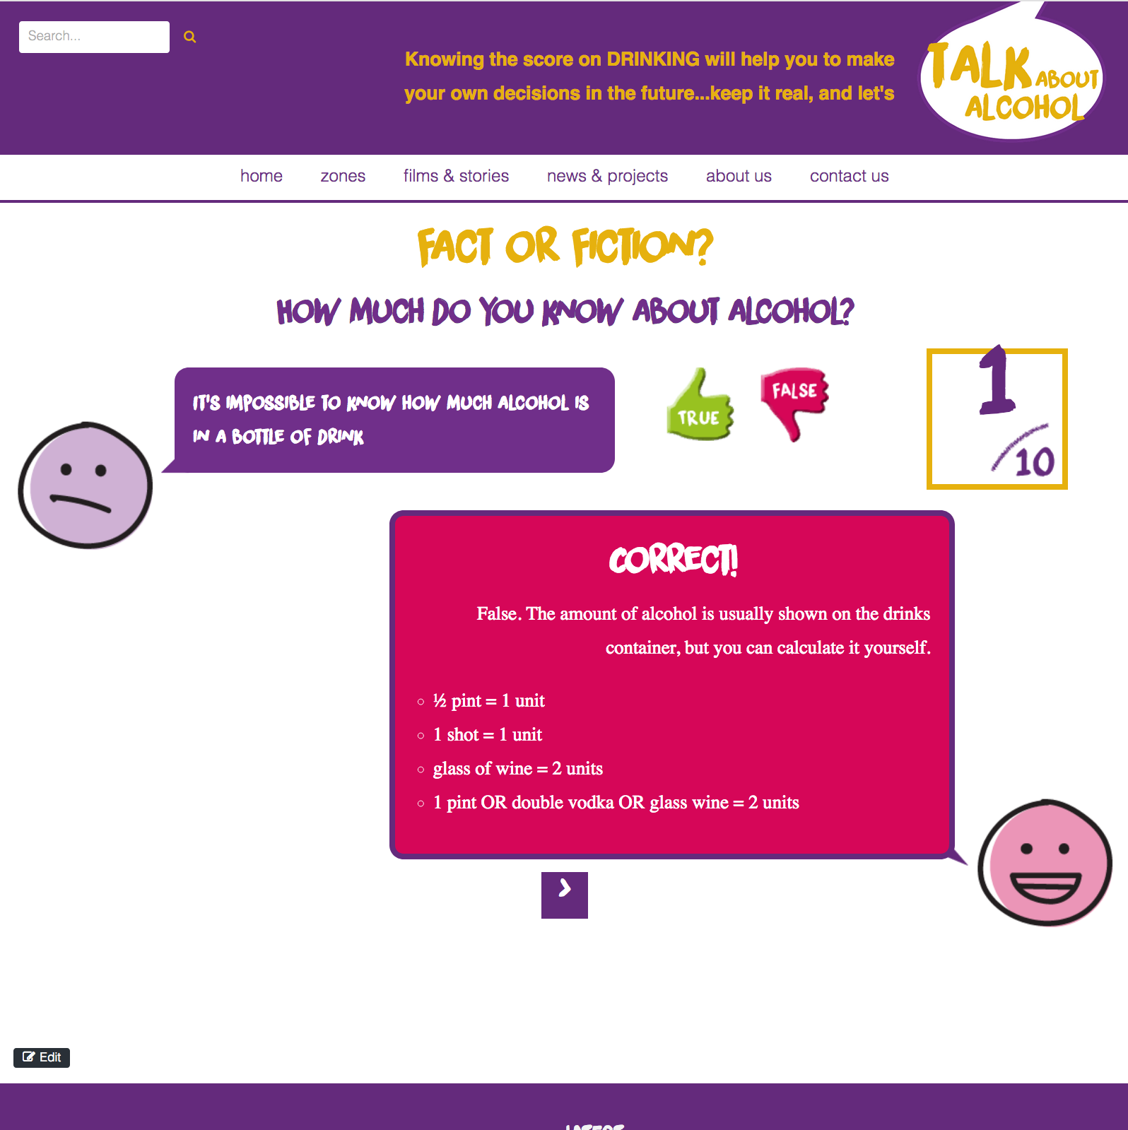
ICE BREAKERS Choose one from the following:
Four Hoops (see next slide)
Crossing the circle hot seat show of hands (link to webpage)
Talk About Alcohol Online Learning Zone - Fact or fiction activity: www.talkaboutalcohol.com/fact-or-fiction/
Notes:
USEFUL FACT:
USEFUL TIPS:
Using an ice breaker game and quick fire questions helps to overcome a reluctance to talk about attitudes to drinking.
Almost all of us, even if we don’t drink, are affected by alcohol at some point, what matters is how we use it.
Identify what issues students are confused or unsure about and use this information to plan your future lessons.

Slide 7
ICE BREAKER: Four Hoops
In 4 groups, visit each hula hoop in turn and discuss the statements that are in each one. Think of other drugs (legal or illegal) that might be one of the below.
Statements:
Alcohol is a stimulant
Alcohol is a depressant
Alcohol is a pain killer
Alcohol is hallucinogenic (makes you see things that don’t exist)
Decide whether they true or false.
Discuss as a whole group.
Notes:
USEFUL TIPS:
Replace the questions on this slide with your own questions, if needed
Alternative statements could be:
different types of drinks and the number of units in them
different laws
This allows students to discuss misconceptions and build knowledge in an exploratory way. The learning outcome of the four hoop activity is for students to realise that alcohol is a legal drug and is a depressant – that doesn’t mean it makes you feel depressed but that it slows down your reactions, actions, coordination and functioning. An example of a stimulant is coffee, and example of a pain killer is aspirin or paracetamol, a hallucinogenic would be a magic mushroom. Alcohol may make you feel more stimulated after one or two drinks, but this is then followed by a low as the alcohol slows you down, they may feel tearful, depressed, angry, sick or sleepy. Some students may say alcohol helps drown your sorrows and so is a pain killer. Drinking for stress or to feel better can lead to dependency and the problems will still be there once the alcohol has worn off. Alcohol is not a hallucinogenic, too much alcohol can make you act out of character and do stupid or dangerous things, some of which you may not even remember, however.

Slide 8
ICE BREAKER: Crossing the circle /Show of hands
Standing in a circle, cross to the other side if the statements apply to you.
Or sitting there, stand up and then sit down again in any of the following statements apply to you.
What do you think this activity shows?
Notes:
USEFUL TIP:
Read out the statements listed one at a time. Some questions should be paused at for feedback such as naming five different types or brands of alcohol and adverts that may have been seen. You will need to tailor the questions according to the age and experience of the children. The questions that give you a little information about the children’s use of alcohol should not be reacted to and the child not questioned, it helps give you an idea of who is drinking/going to parties/ engaging in risker behaviour in a non-judgemental and very quick fire way.
For younger children the activity shows they are affected by or are aware of it through social lives, society and the media
You can adjust the statements according to the age group.
By the end of the statements most students will probably have moved at least once – most more than that.
You’ve seen adverts for alcohol on TV
You can name 5 different kinds of alcohol
You can name five different brands of alcohol
You’ve tried alcohol
You’ve read seen articles or programmes on binge drinking or drink drive?
You’ve been to a pub
You’ve been to a party without adults with alcohol available
You know someone whose had a hangover
You’ve seen health adverts on the dangers of drinking too much
You’ve had some alcohol during the last week
You know someone whose been drunk in the last month
Ask them what they think this game demonstrates. That whether you drink or not alcohol is all around us in society so it’s important for us to understand it’s impact and effects whether we choose to drink or not

Slide 9
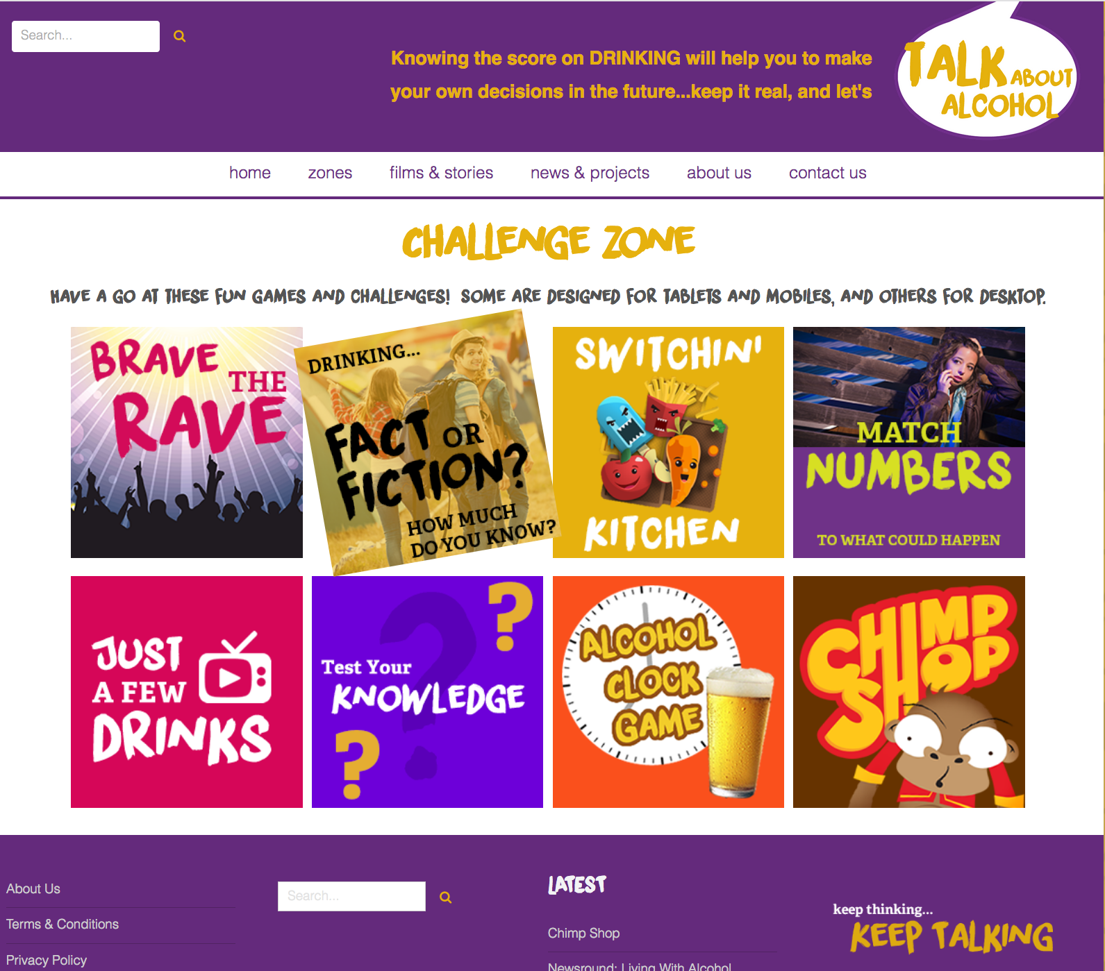
ICE BREAKER: Fact or Fiction
http://www.talkaboutalcohol.com (accessed via the Challenge Zone)
Notes:
USEFUL TIPS:
If you prefer and have access to the internet in class you can ask students to spend some time on the fact or fiction activity of the talkaboutalcohol.com on line learning zone, (accessed via the Challenge zone) Ask them to write down their scores and to feed back on the answers they got right or wrong. This can then help you plan other lessons and activities. http://www.talkaboutalcohol.com/fact-or-fiction/

Slide 10
ACTIVITY 1
Example only –
content removed
Notes:
USEFUL FACT:
In 2016, 56% of 11 – 15 year-olds in the UK hadn’t drunk alcohol – so don’t presume your students are all drinking. Gauge the knowledge and experience of your students only.
Only 15% of 11 year olds have had a whole drink and 6% of 11-15year olds drink weekly (<1% of 11 year olds and 10% of 15 year olds)
USEFUL TIPS:
Use the completed answer sheet to stimulate further discussions and to encourage students to think beyond the obvious motivations for drinking.

Slide 11
ACTIVITY 1a
Example only –
content removed
Notes:
USEFUL TIPS:
Replace the questions on this slide with your own questions

Slide 12
ACTIVITY 1b
Example only –
content removed

Slide 13
ACTIVITY 1c
Example only –
content removed
Notes:
In turn, take a reason for why people drink or where people drink and place it on the scale of high risk, medium risk or low risk and have a discussion as to why.
Look at why most under 16s choose not to drink, the reasons why this might be and why both adults and teenagers think far more teenagers are drinking and getting drunk that actually are – This is true about smoking and trying drugs too.

Slide 14
WHAT CAN YOU REMEMBER?
Example only –
content removed

Slide 15
WHAT HAVE WE COVERED TODAY?
Example only –
content removed

Slide 16
HOMEWORK
Example only –
content removed

