Slide 1
AET National Alcohol Conference
Louise Pope
Head of PSHRE
Chew Valley School
lpope@chewvalleyschool.co.uk
@philosophypope

Slide 2
Develops knowledge, skills & understanding
Within context of PSHE / healthy lifestyles education
Explores attitudes
Top Ten Tips for teaching PSHE (alcohol and drugs)
Differentiated (age, experience, SEND etc.,)
Enables young people to lead safe, healthy responsible lives
No shock/ scare tactics

Slide 3
1. Ground Rules
Respect each other
Listen to each other
No personal info
Not laughed at
It’s OK not to know
Ok to pass
Confidentiality

Slide 4
2. Environment
Every voice matters

Slide 5
Ice-breakers / energisers
3. Get them moving
Bounce the ball – say a drink / fact

Slide 6
Have a Guess – Yrs 8 &10s
4. Good research base
55
% have never had an alcoholic drink

Slide 7
Have a Guess – Yrs 8 &10s
87
% didn’t drink alcohol in the last week

Slide 8
Have a Guess – Yrs 8 &10s
91
% hadn’t been drunk in the last week

Slide 9
Alcohol Clock Activity
5. Active Learning Strategies
Continuums

Slide 10
Hoops for discussion
Why do some young people drink?
Why do young people choose not to drink
Why do some young people not get into problems when they drink
Why do some young people get into problems when they drink

Slide 11
Diamond 9

Slide 12
Hot seat

Slide 13
6. No Question is a silly question
7. Honesty is the best policy
8. No scare tactics!

Slide 14
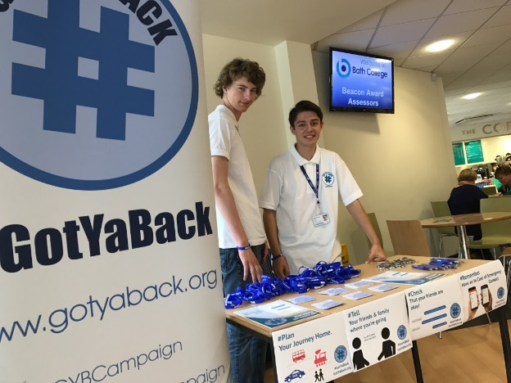
9. Signpost sources of help and support

Slide 15
10. Always ask for feedback

