Slide 1


National Alcohol & Drugs Education Conference 2018
Evidence based practice in alcohol and drugs education Empowering young people to make healthy choices
Targeted approaches for vulnerable populations including pupils with special needs and looked after children.
Liverpool John Moores University
21st June 2018

Slide 2
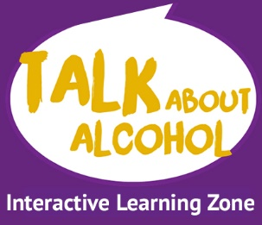

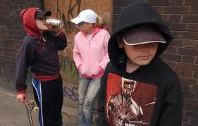
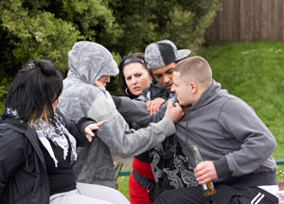




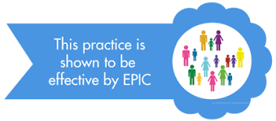
The Alcohol Education Trust
A national charity that works with schools, parents, carers, health workers, youth outreach teams, and children aged 11-18 to prevent underage drinking, reduce drunkenness and its associated harms and help keep young people safe around alcohol
https://www.facebook.com/talkaboutalcohol/
Twitter: @talkalcohol
www.alcoholeducationtrust.org
www.talkaboutalcohol.com

Slide 3
Why is alcohol education so important?
Underage drinking has halved in the last decade 38% of 11–15 year olds have tried alcohol (the lowest since surveys began) 8% had drunk alcohol in the past week. Average age first while drink 13 ½. However teenagers who drink regularly before the age of 15 are :
11 times more likely to suffer unintentional injuries after drinking.
Acheive lower GSCE grades affecting their life chances (fall of 20 points) – difference between A* and C
Significantly more likely to experiment with other substances:NPS, cannabis or to smoke
Teenagers who get drunk are far more likely to:
Injure themselves or someone else – even accidentally
Engage in unsafe sex, (risking STIs and unplanned pregnancies)
Be robbed – especially of cash and mobile devices
End up going home with a stranger or on their own
Get into a fight, an argument or relationship problems
Get into trouble with the police and end up with a criminal record
Key aims: Delay the onset of drinking and reduce the prevalence of & risks from drunkenness & bingeing

Slide 4

Why a separate approach for alcohol?
Alcohol is all around us – part of our society 80% of adults drink
Not a simple ‘just say no’ message like drugs and cigarettes
So we need young people to recognise and to categorise risk
To feel confident in making informed decisions (social and physical effects)
To learn how to look after themselves and their friends, whether they choose to drink or not (consent)
To understand they are likely to behave out of character and do other risky things the more they drink and the younger they are when they begin drinking
To understand the consequences of our decisions and what we may ask others to do (legal)

Slide 5
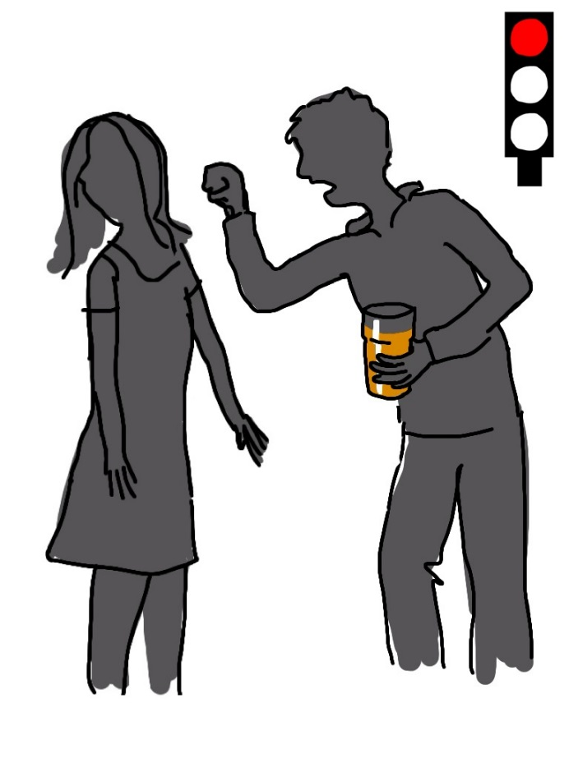
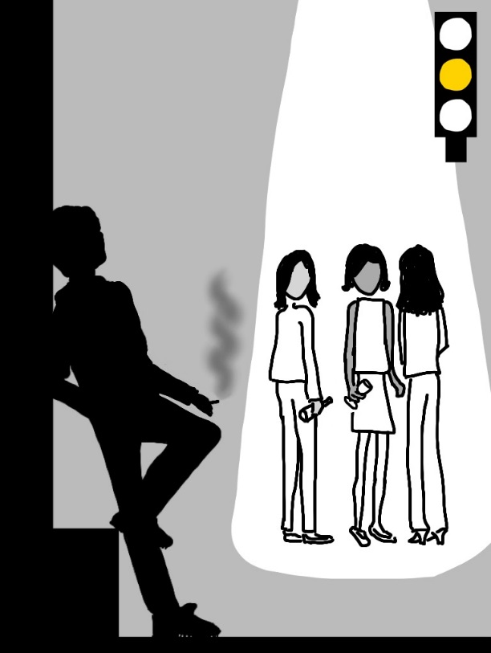
Reaching vulnerable children with more targeted approaches activities around images, colours and stories in small groups or one to one to ensure that more vulnerable children understand consent, motivation can categorise risk are helped to stay safe around alcohol. .
Tell me and I will forget
Show me and I will remember
Involve me and I will understand
1 in 5 children across the UK have some level of special educational needs

Slide 6
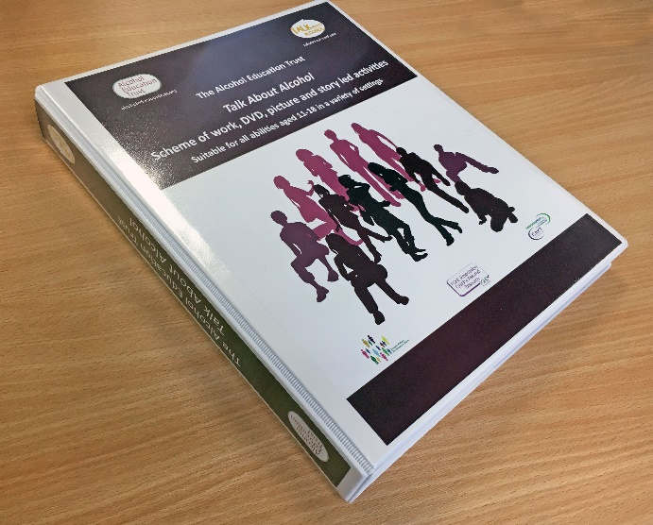
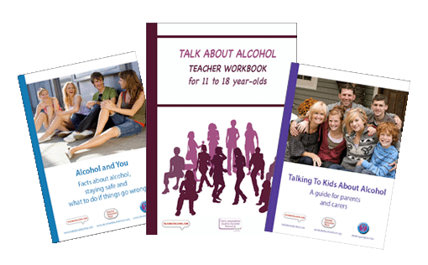
Fully evaluated teacher workbook and enhanced workbook with bespoke lessons for children with moderate learning difficulties
- 60 picture and story activity cards
DVD of 4 BAFTA award wining short films
30 lessons for varying ages and experience and abilities
6 bespoke lessons for children with moderate learning difficulties
National runner up for best secondary school resource 2017
A teacher workbook by topic freely available on line to download.
Information guidance for teenagers ‘Alcohol and you’
Information guidance for parents/carers
Talking to kids about alcohol

Slide 7
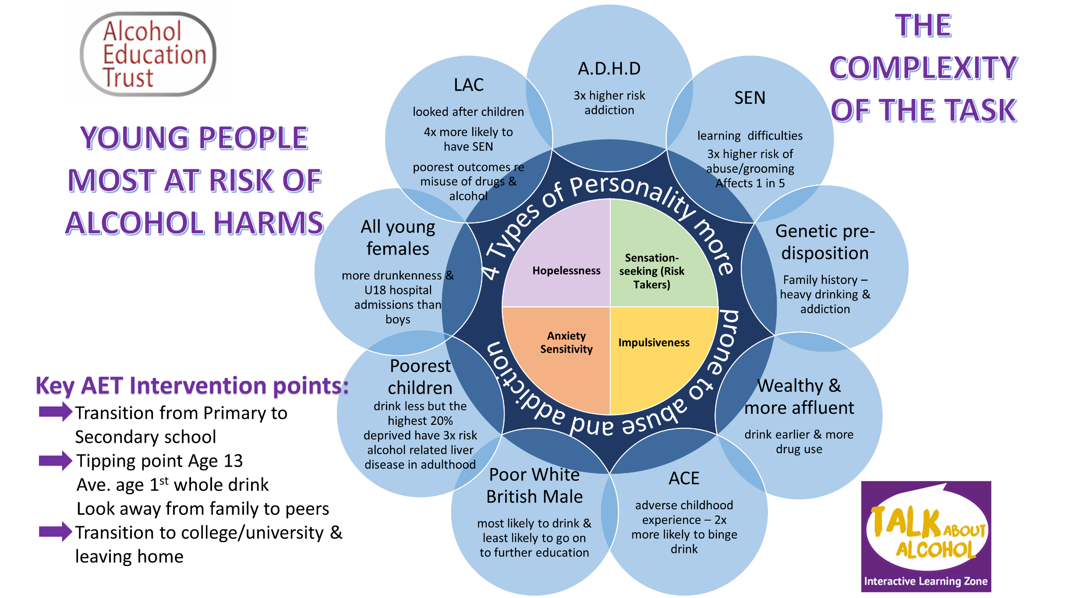

Slide 8
Desired outcomes
Ensure young people are prepared for the risks that surround alcohol use in society as they get older
Young people with SEN are more vulnerable to abuse and grooming. By learning about consent and how alcohol affects decision making we help ensure safety.
Ensure young people know where to go for support and advice through effective signposting and referral
Encourage personal responsibility, informed decision making and responsible choices through discussion and rehearsal of ‘true to life’ scenarios.
Delay the onset of drinking and reduce the harms and increased risk taking associated with drunkenness and binge drinking

Slide 9
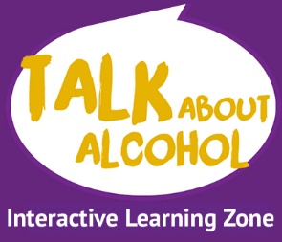
6 bespoke powerpoint presentations
Go to teacher/Professional area
Click on resource by topic
Go to visual rich/SEN resources
There is a password protected area for some resources that are only available via the subscription area or SEN area
We do have a grant ( only a little left now for 2019!) to fund schools or organisations with a high level of children with learning difficulties and for looked after children – both of whom are significantly more vulnerable to abuse and alcohol related harm.

Slide 10
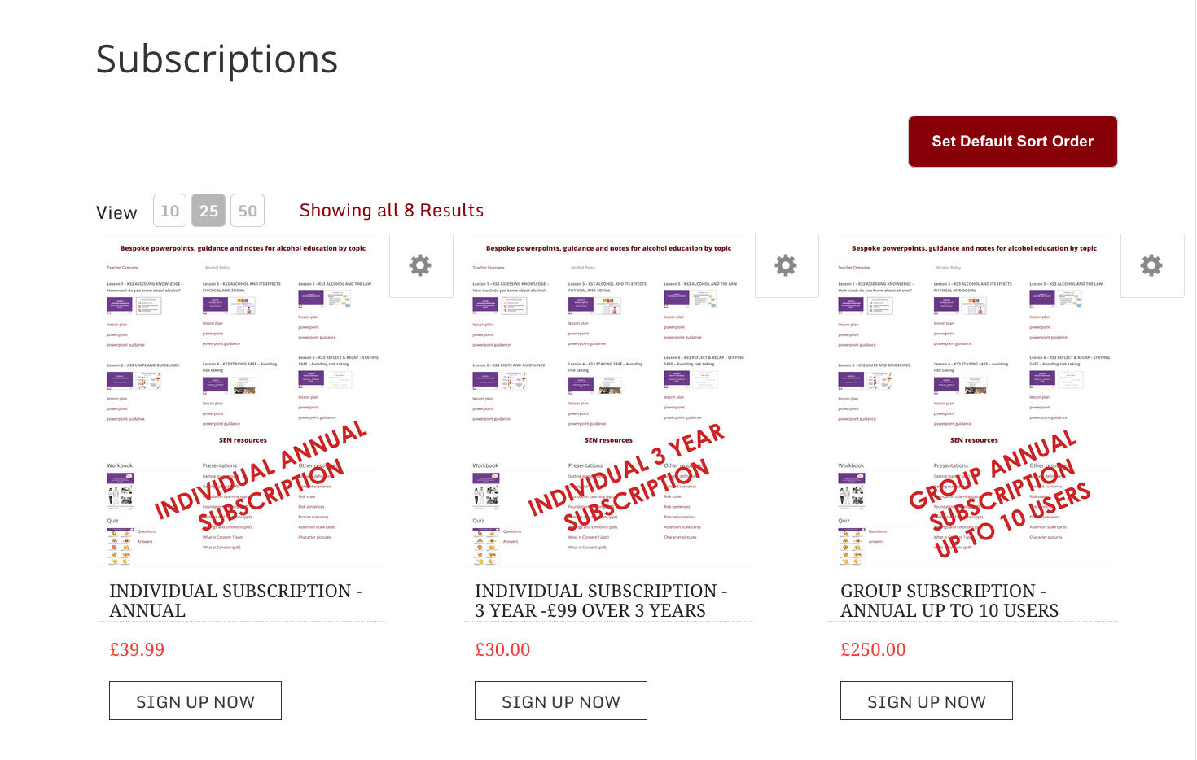
Choice of subscription options
6 bespoke SEN powerpoints for SEN – special offer of £99 for three years as well as 6 NFER evidenced lesson plans and powerpoints.

Slide 11
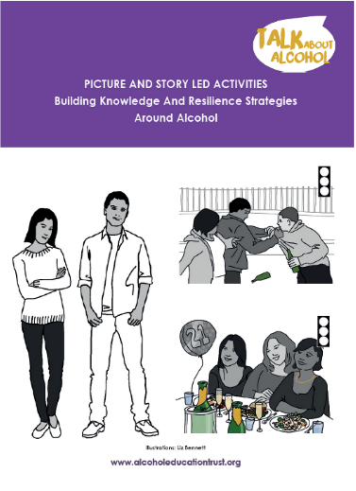
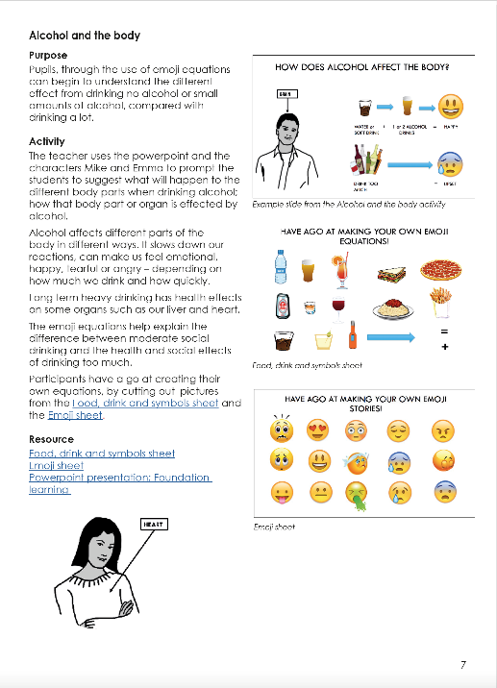
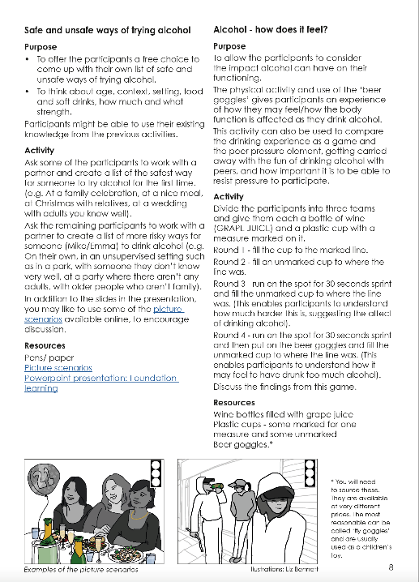
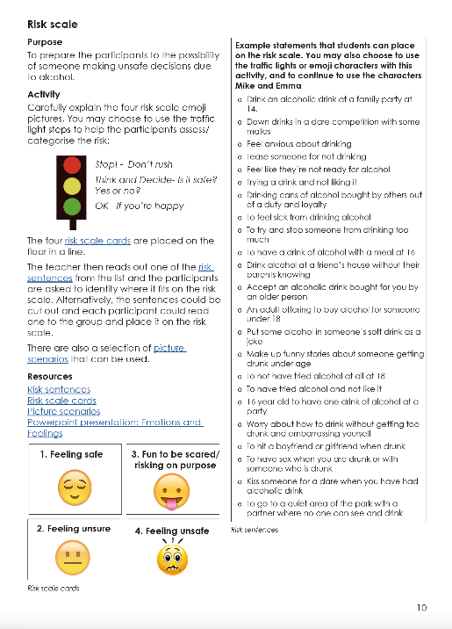
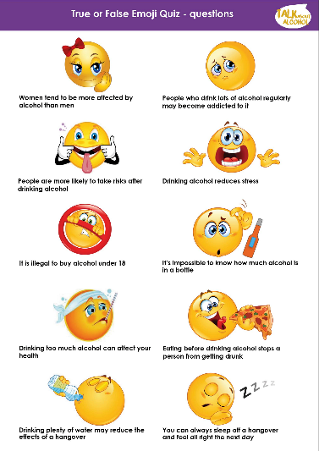
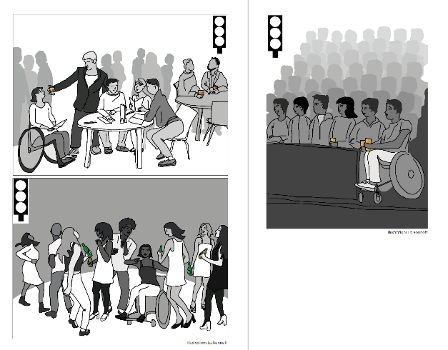
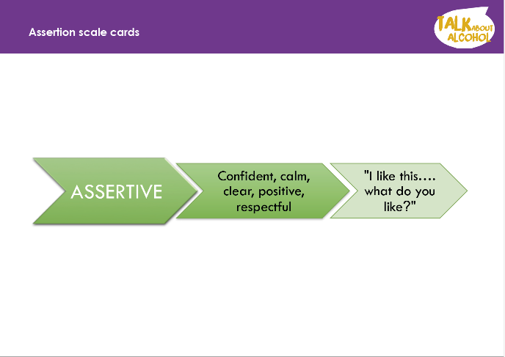
Bespoke resources for children with moderate learning difficulties

Slide 12
Talk About Alcohol Workbook - 5 Key Sections
Assessing Knowledge
Units
Effects of Alcohol
The Law
Staying safe
    16+ section plus extra activities
Only 4 lessons for Year 8 and 2 for Year 9

Slide 13
SEND Resource - 4 Key Methods
Distancing - This method allows the characters (Emma and Mike) to make mistakes and find themselves in risky situations.
Active Learning - The participants are encouraged to move around and engage in role play and discussions keeping the participants interested and engaged.
Building on existing knowledge – it is likely that the participants will have experience of heightened emotions, by using characters we can use this to explain how alcohol might make people feel.
Practical resources - We believe that tangible objects and pictures will help participants to engage with the concepts and issues. ‘Rehearsal strategies’
“Tell me and I will forget”
“Show me and I will remember”
“Involve me and I will understand”
1 in 5 children across the UK have some level of special educational needs

Slide 14

Personal Social and Health Education principles
Issues around disclosure
Ground rules – ‘I know someone who’
– nothing personal
Ask it basket
– discreet and allows time for a measured response
Sign posting:
Within school or organisation – head of pastoral care, school nurse
Whole schools ethos – alcohol policy (governors, parents and staff)
local services:
NATIONAL HELP:
Childline: (childline.org.uk) 0800 1111(Freephone)
Drinkline: 0300 123 1110
Adfam: (adfam.org.uk) 0207 553 7640
Alateen: 0207 403 0888
Addaction: (addaction.org.uk) 0207 251 5860
Knowledge and guidance for student websites www.talkaboutalcohol.com and
www.riseabove.org
?? ?

Slide 15
Ground rules
We won’t discuss anyone here
We study alcohol through stories and pictures not personal experience
We will respect others’ opinions
We will ask questions if we need to
We will listen to others and speak one at a time
We’ll turn mobile phones to silent and leave them in our bags
Notes:
We won’t discuss any of the people present, staff or participants.
We study alcohol through stories and pictures not personal experience.
We will respect others’ opinions.
We will ask questions if we need to.
We will listen to others and speak one at a time.
We’ll turn mobile phones to silent and leave them in our bags during the session to help us all to focus on what we are studying.

Slide 16
Assessing knowledge:
The decision whether to drink or not baseline activities
Assesses level of knowledge and gaps
Identifies the risk takers
Gives sensitivity to anyone with problems
Allows you to plan next session based on the experience and knowledge of the students
Referral to relevant local services if worried about any child
Icebreakers help pupils relax and participate

Slide 17
Examples of ice breaker activities
4 hoops statements such as:
- Alcohol makes you hyper
Alcohol makes you act differently
Alcohol makes you see things that aren’t there
Alcohol slows you down
Using characters Mike and Emma
Cross the circle show of hands

Slide 18
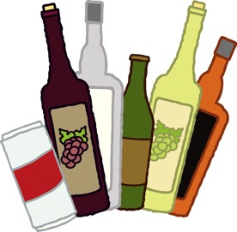
What is alcohol?
Alcohol is a legal drug
Alcohol is made from fermented fruit like grapes and apples, or cereals
Alcohol drinks can have different flavours and strengths
Alcohol affects how you feel, act, react and behave
Alcohol slows down your thoughts and movement
Notes:
Alcohol is a legal drug
Alcohol is a psycho active substance – something that affects how you feel, act, react and behave
Alcohol is a depressant – in that it slows down your reactions and coordination
Caffeine is a different type of legal drug - a stimulant that makes you feel awake!
Alcohol is made from fermented fruit like grapes (wine), cereals (beer) and apples (cider). It comes is different flavours and strengths – a small drink like vodka is much stronger than a larger beer for example

Slide 19

Crossing the Circle/Hot seat/show of hands
Lets have a go!
This activity can be done through a rapid fire ‘hot seat format’. You can adjust the statements according to the age group.
Get students to stand in a large circle around the room or stand up when a statement applies to them
1. Read out the statements listed one at a time.
2. If students feel that the statement applies to them, they should cross the circle to the other side.
3. By the end of the statements most students are likely to have moved at least once – most more than that.
Learning Objective: Almost everyone is affected by alcohol, whether they drink or not as it is all around is in society.
Teaching outcome: helps build your knowledge of the pupils experience, expectancies and knowledge of alcohol.
Alter questions according to the age and experience of the group

Slide 20




Do you know much about alcohol?
Can you name some different types of alcoholic drink?
Have you seen adverts about alcohol?
Have you seen campaigns about alcohol and driving?
Have you seen anyone who is drunk?
Have you been in a pub or off licence?
Do you know someone your age who has tried alcohol?

Slide 21
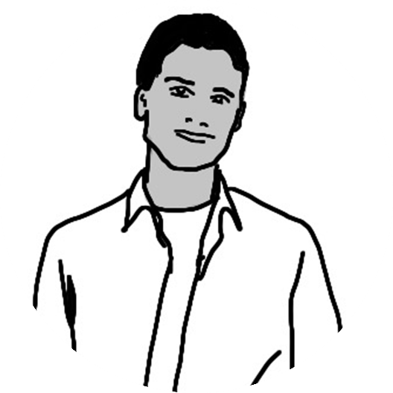
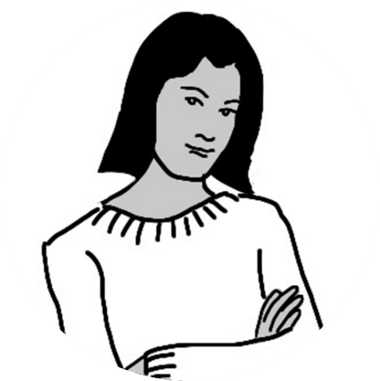
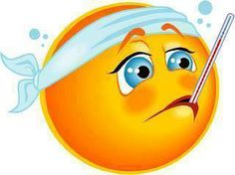



Use of characters Mike and Emma and emojis.
Focus around assertiveness, consent and questioning

Slide 22







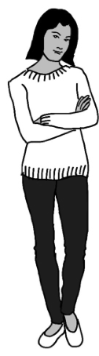
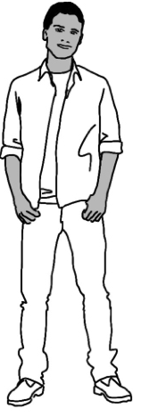




















Creating Characters
What hobbies do Mike and Emma enjoy?
Notes:
In order to study this subject safely we will use a story with two characters
Emma and Mike (other names can be chosen) who are a similar age to the participants.
The teacher encourages the participants to suggest some hobbies and interests for the characters.
You can encourage the participants to name real places and activities locally.
The characters will come to represent an additional couple of people in the group who might live locally and have similar behaviours and could take similar risks.

Slide 23



Alcohol and the Effects: physical and social
Body- interactive via www.talkaboutalcohol.com and worksheet
    Physical, social and psychological
Short and long term effects ( page 40/41 and 44/45)
Emoji Equations (SEN guidance)
Getting the balance right – how much is too much?
Just a few drinks Anna’s story or Jordan’s story and accompanying lesson plans http://alcoholeducationtrust.org/teacher-area/staying-safe-avoiding-risk-taking/staying-safe-ice-breakers/

Slide 24
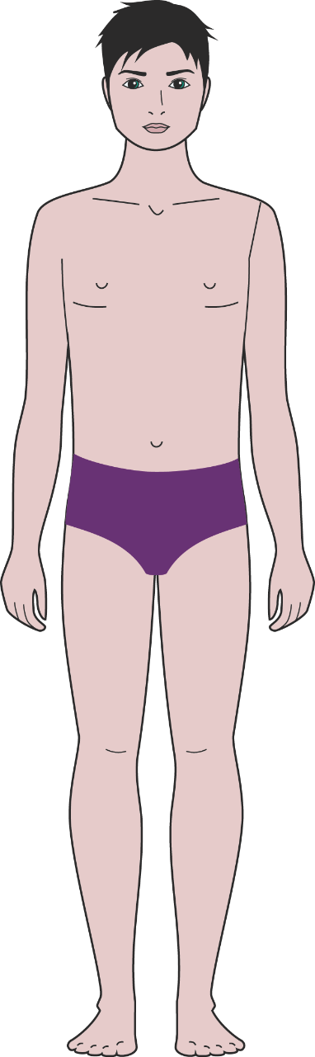
Alcohol and the body
When people drink alcohol it affects how they feel, act and behave.
After a little alcohol and someone may feel relaxed and happy
After one or two drinks it can affect our health and different parts of the body too

Slide 25
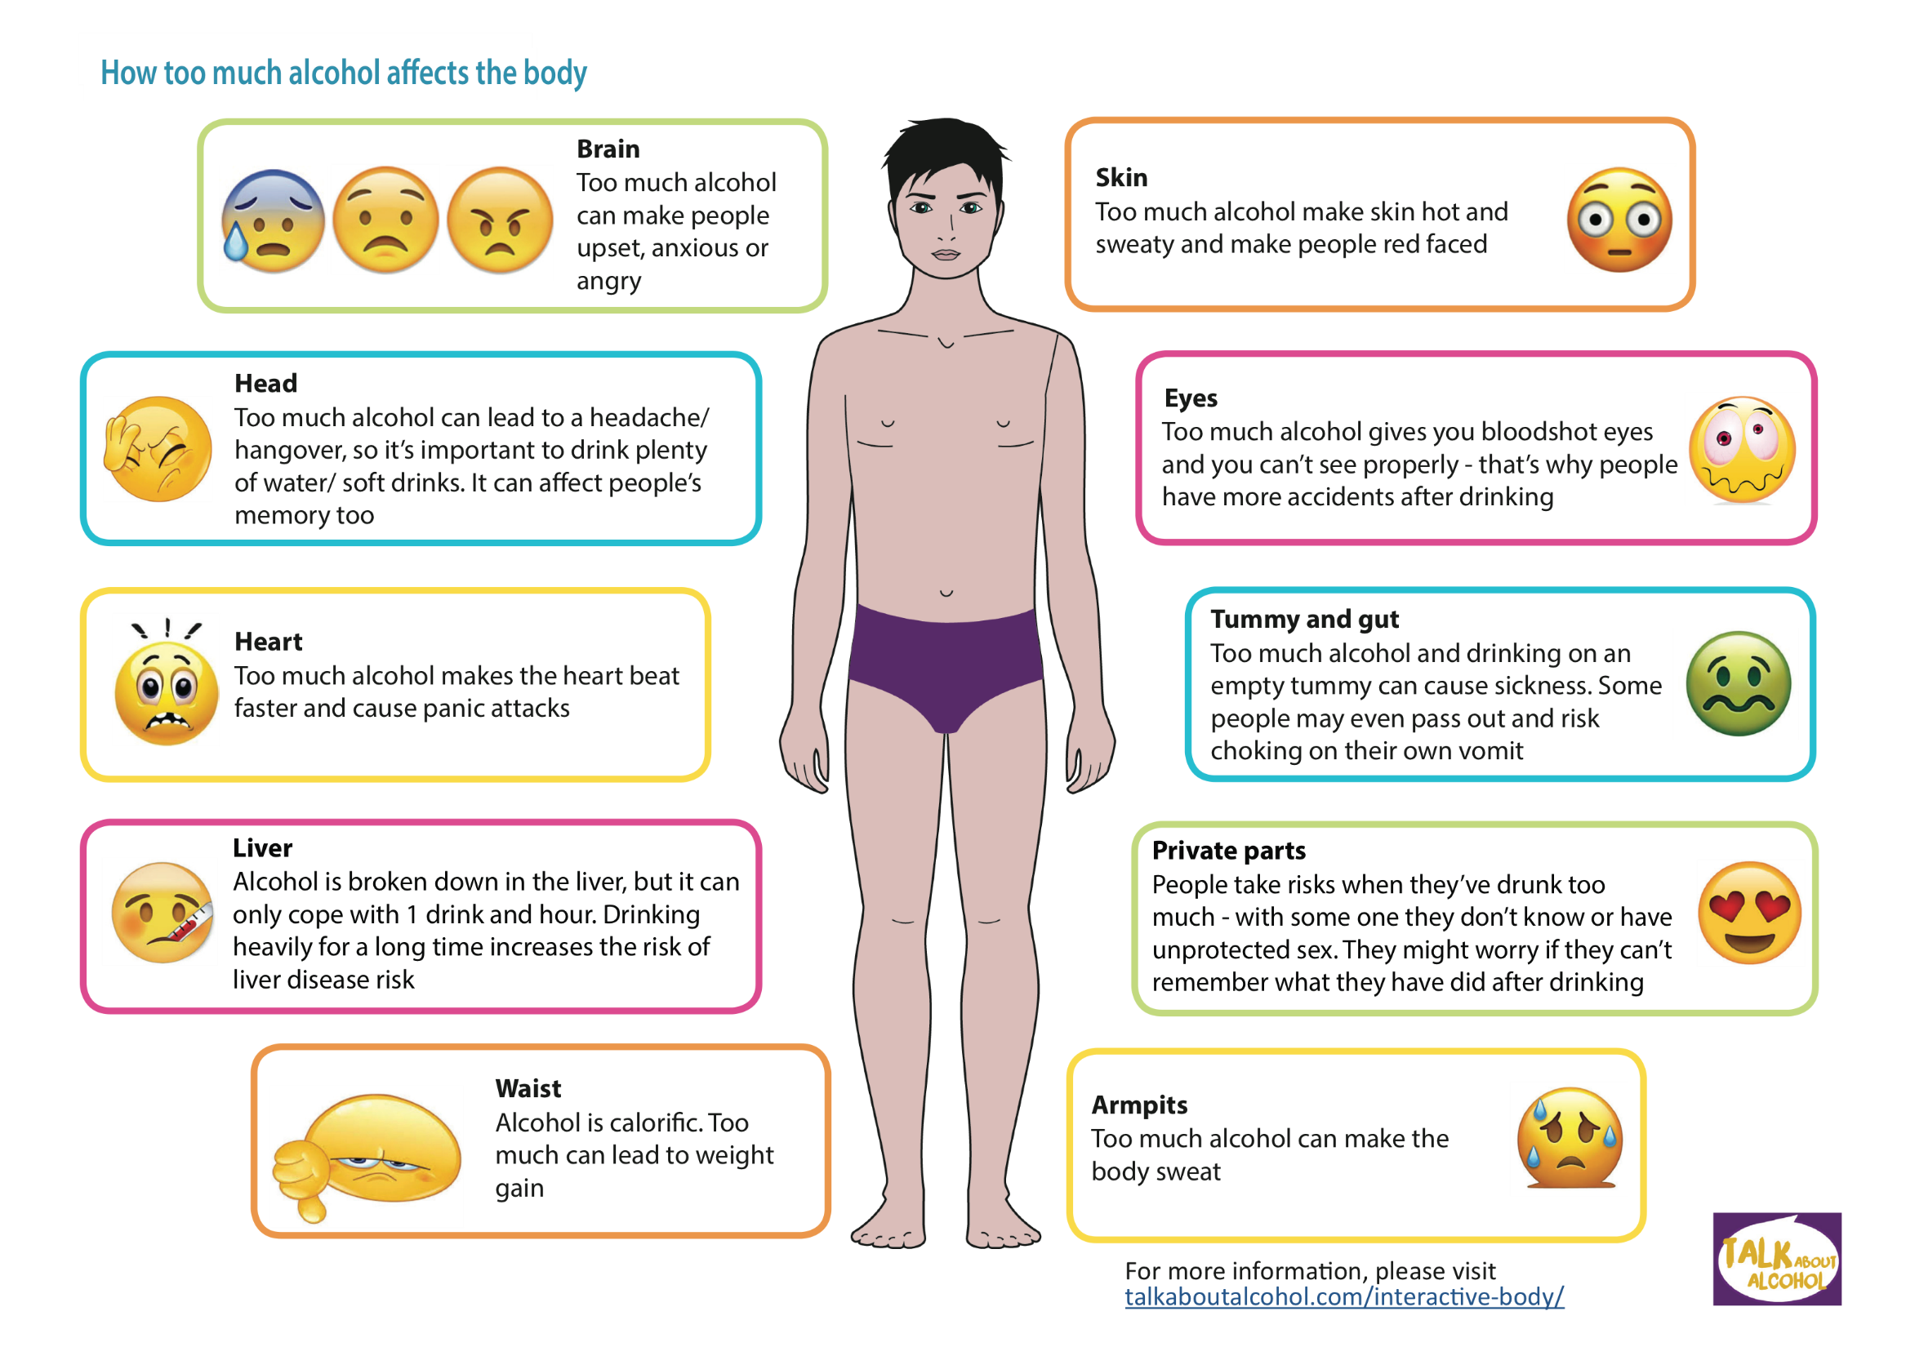

Slide 26



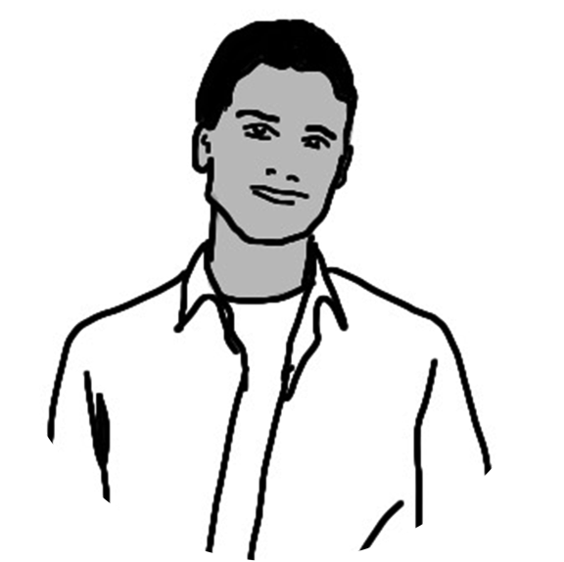




Alcohol and the brain
Brain
Water or + 1 or 2 Alcohol = Happy
Soft Drink Drinks
Drink too = Upset anxious angry
much
Don’t Leave Your Brain At Home Clip
http://www.alcoholeducationtrust.org/teacher-area/staying-safe-avoiding-risk-taking/staying-safe-ice-breakers/
Notes:
Brain
Too much alcohol acts a depressant on the brain, the control centre of the body. It can make the drinker feel happy for a little while, but that’s followed by a depressing low. Long-term drinking can kill off brain cells and lead to memory loss and mental problems

Slide 27


How much is too much for adults?
For healthy adults,
for both men and women, one or two drinks a day is ok
Don’t save up drinks and binge drink
Always have non drinking days each week
Children under age 15 are advised not to drink at all – 6 in 10 choose not to.
1 small alcopop
OR
2 small beers
Notes:
for healthy adults doctors say one or two drinks (2-3 units) a day for women and two of three (3-4 units) for men is OK
Make it clear that talk of drinks and guidelines are for adults over the age of 18 and not young people, as alcohol has a greater effect on the brain and organs of young people, making them more likely to do risky things, be sick or unwell.
If someone drinks a lot reactions slow down, they may be sick, pass out, have an accident, get involved in a fight or dangerous things

Slide 28

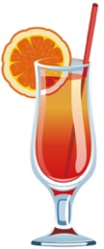
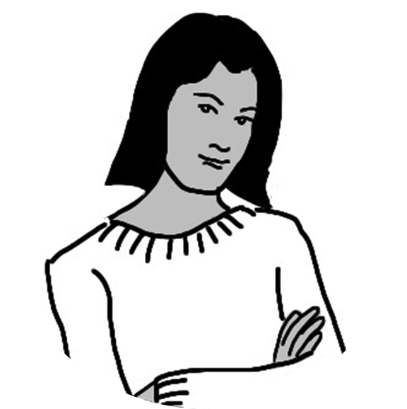


Alcohol and the heart
Heart
Water or 1 or 2 Alcohol = Content
soft drink + drinks
Drink too Heart beats fast = panic
fast attacks
Notes:
HEART
Drinking large quantities of alcohol over a short period can cause irregular heart beats and shortness of breath, leading to panic attacks and illness. If an adults drinks one or two drinks, it’s fine, but it’s important to be physically active, eat a healthy, balanced diet and to avoid smoking if you want to be ‘heart healthy’

Slide 29
Units and guidelines
Have a demonstration kit of a jug of squash, glasses of different sizes, empty cans and bottles of different alcoholic strengths and types of alcohol. Emphasise Chief Medical Officer guidance and why it exists:
An alcohol free childhood to at least before the age of 15 is best
Responsible and low risk guidelines for adults
What is a unit and what are the daily guidelines?
Drinks are not the same: Abv, size of pour,
Back labels
Why is there a limit of 14 units a week for men and women?
Blood alcohol concentration: BAC
When not to drink
Notes:
29
FACT 3 - The Tipping Point’
Just 3% of 11 year olds think it is okay to try getting drunk or be drunk weekly – however, this rises to 48% of 15 year olds, with 32% thinking it’s okay to get drunk once a week (The Information Centre, 2005).
This is why it is so important that you talk about drinking, its effects and potential consequences in a balanced way before the age of 13. A study in 2008 by Positive Futures of 1,250 of 10-19 year olds living in deprived communities found that age 13 was a “tipping point” with 42% of respondents beginning to drink alcohol by 13.

Slide 30
Any idea why we have units and guidelines?
To help us work out how much is too much and to balance the benefits and risks of drinking as adults.
To help us work out how much alcohol is in different types of drinks
To understand when not to drink
To help us understand how alcohol is broken down by the body and at what rate
Why no safe level for under 18’s?

Slide 31

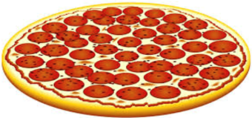


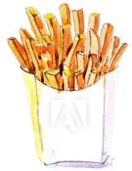




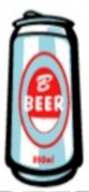
What is a drink?
= 0 units
        EATING BEFORE OR WHILE DRINKING IS BETTER
= 1 units
= 2 units
DRINKING PLENTY OF WATER OR SOFT DRINKS KEEPS PEOPLE HYDRATED AND IN CONTROL.
IT SAVES MONEY TOO!
= 3 units
Notes:
= 0 units
= 1 units
Half a pint of beer, cider, lager or a small alcopop
= 2 units
One pint of beer, cider or lager or a small glass of wine
Water, juice or fizzy drinks
A can of high strength beer, cider or lager
= 3 units

Slide 32

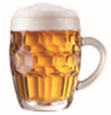






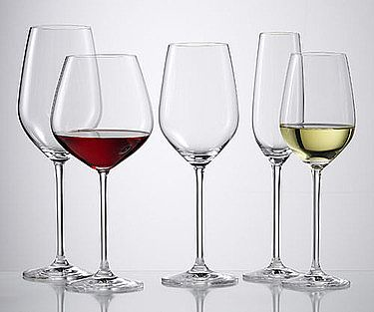
How can you measure how much is too much?
How many units in a drink?
CHECK THE LABEL
Most drinks tell
1
=
you how many
Glass sizes and the alcoholic strength of drinks make a big difference to how many units you drink.
Top ups?
Mixing?
Size of pour?
units are in them
Know your limits
A
small
bottle (275ml)
A half pint
A
single
Units of
of
lower strength
alcohol per
of
lower strength
(4%)
measure of
(4%)
125
ml gla
alcopop
lager, beer or cider
spirit (40%)
ss
2
=
A
standard
glass (175ml) of
A pint of
A 440ml can of
A
double
measure of
lower strength
(4%)
medium strength
lower strength
(4.5%)
spirit (40%)
(12%)
wine or champagne
lager, beer or cider
lager, beer or cider
Notes:
How can you measure how much is too much?
Glass sizes and the alcoholic strength of wine make a big difference to how many units you drink.
If you use beautiful large glasses, just fill them a third full - wine specialists will tell you that this allows the wine to breathe and will let you swirl, sip and appreciate the wines to their full extent. There are some wonderful lighter wines too.

Slide 33
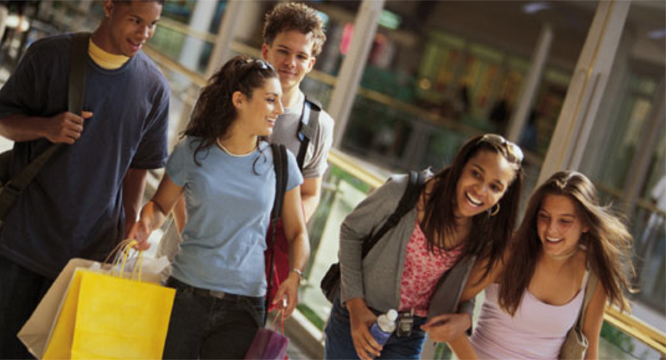
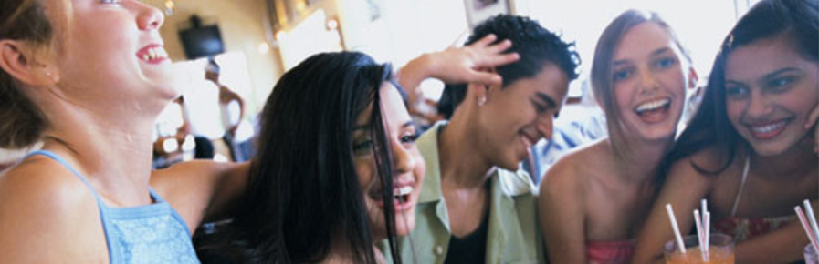
student led: work in small groups to plan an 18th Birthday party
spend 10 minutes planning an evening out to celebrate an 18th Birthday party ( use Mike or Emma if more appropriate)
Think about where you meet, getting ready,
when/what you would eat,
how many people are involved,
where you go at what time
what you do during the course of the evening
How you plan to get home
how much and what would drink you during the evening?.

Slide 34
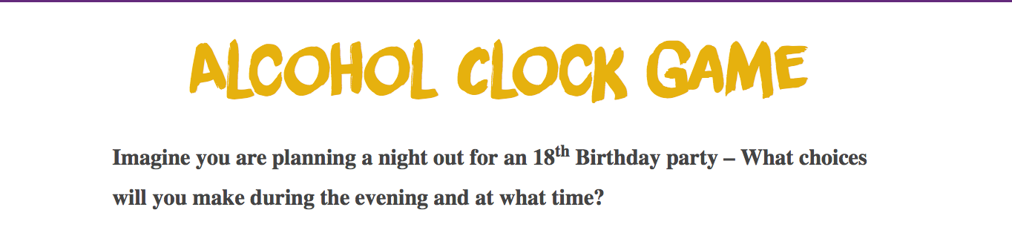
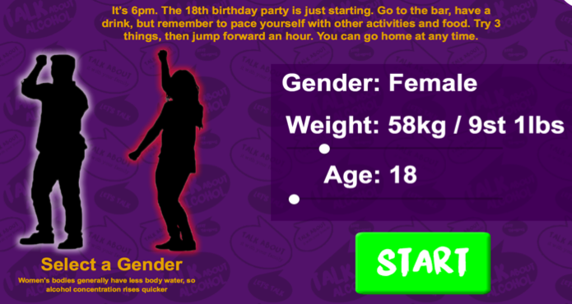
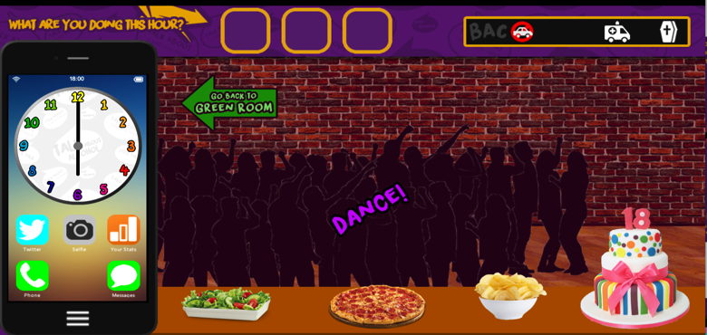
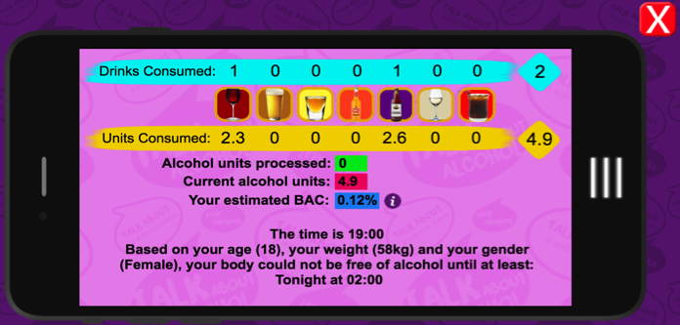
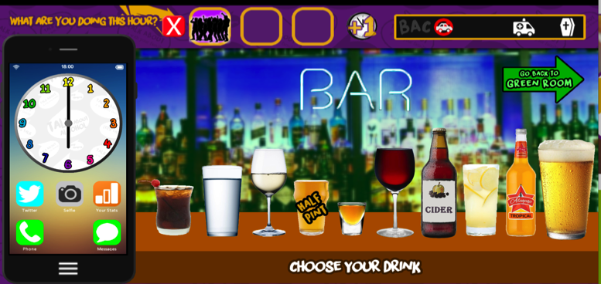

Slide 35
Alcohol and the law
Use www.talkaboutalcohol.com to assess knowledge and misconceptions or to test knowledge towards the end of the session
Use an ice breaker activity – conscience alley
Let each student have a copy of the info –worksheet
Use Alan’s story and ask students which laws have been broken at what point.

Slide 36
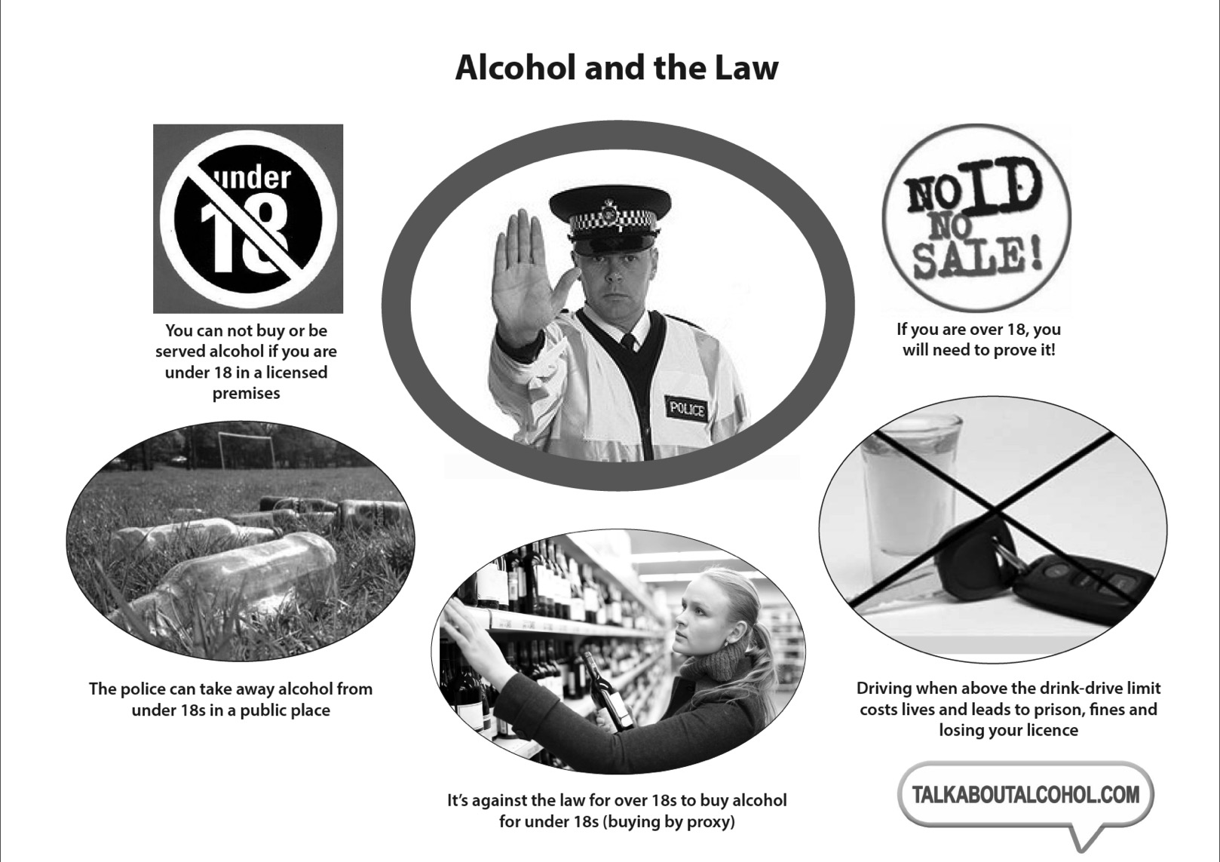
Alcohol and the law
Notes:
Work through the Alcohol and the Law sheet. Participants should understand that it is illegal to buy or be served alcohol in licensed premises or in a public place when underage.
A parent may or may not allow small amounts of alcohol in the home for those younger than 18, this is not against the law and it is a parental/carer decision.
Strangers/friends/other adults who offer to buy or give you alcohol to those under 18 are breaking the law. This is called buying by proxy.

Slide 37

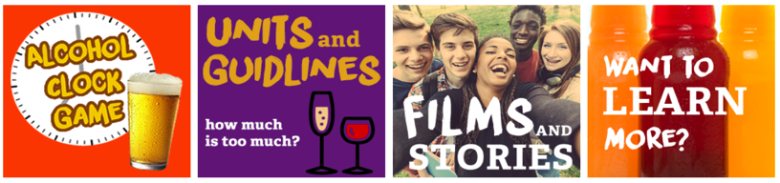
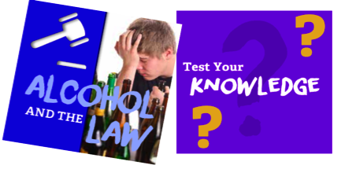

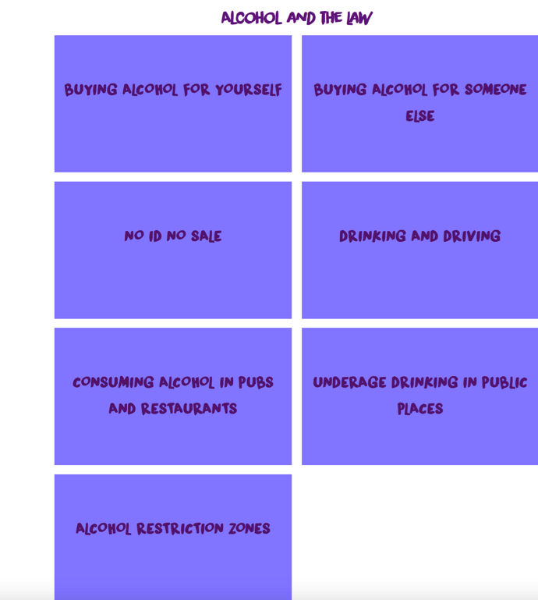
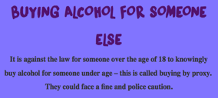
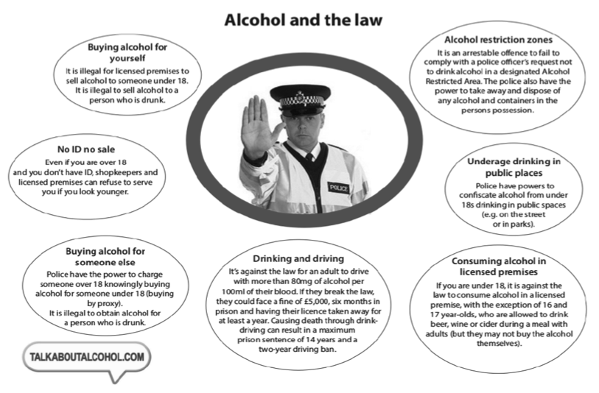

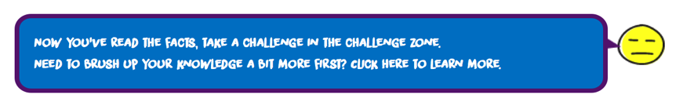

Slide 38
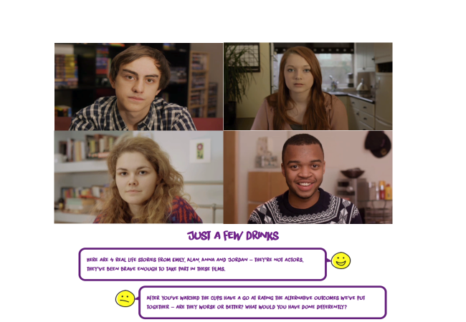
Staying Safe
Use of videos clips for discussion
Risk Scale
Harm Reduction Emoji Equations
Video clips with discussion activity
http://www.bbc.co.uk/programmes/b01qnr62/clips

Slide 39
Staying safe: avoiding negative risk taking
Consequences game: 0 2 4 6 8 pages 72/73
Use Jordans story
Risk continuum and statements
SEN traffic light scenarios and emoji equations

Slide 40
Harm reduction equations
Notes:
The teacher leads the group to use symbols to understand about how to reduce the harm that alcohol can cause.
The teacher uses the emojis symbols and some alcohol and non alcohol drink pictures Including options such as eating, chatting, gaming, dancing, soft drinks. These should be cut out and laminated.
The teacher creates a story using the characters Mike and Emma.
There are examples of emoji equations below and an example sentence could be ‘Mike has one beer at home with his family when his uncle comes round for a birthday party. Mike feels happy and they all say “Cheers, happy birthday uncle!” Then Mike has water when they eat the birthday cake’.
Examples of Harm Reduction Equations
Emma feels shy, she has a cocktail and feels OK and then has a spirit and feels happy. After another cocktail, she feels sexy, but ends up feeling sick and worried about what behaviour has taken place.
Different results can be created by matching up the symbol. e.g. the character can be having a good time but chooses to drink water and have a snack as well as an alcoholic drink so he does not end up unwell from drinking too much.

Slide 41
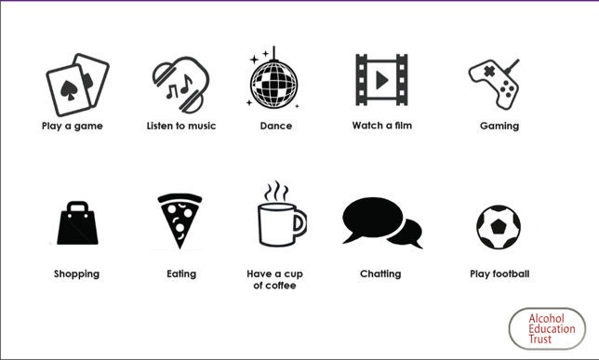


Create you own harm reduction equations

Slide 42
Staying safe: avoiding risk taking
Conscience Alley ice breaker
Use Jordans story
Risk continuum and statements
SEN traffic light scenarios
Consent – Yes & No

Slide 43





The traffic light can help us stop and think before we act!
Stop! NO | Don’t rush. Say ‘No’ if you’re not happy
When we make the wrong decisions

Slide 44




The traffic light can help us stop and think before we act!
When we are unsure
Think and Decide | Is it safe? Yes or No?

Slide 45



The traffic light can help us stop and think before we act!
When we make safe decisions
OK, YES! | If you’re happy and sure you’ve thought the decision through

Slide 46






Using pictures and traffic lights to think about safe and unsafe ways of drinking alcohol
Notes:
use the pictures to think about safe and unsafe ways of drinking alcohol, how much, who you are with, how quickly you drink

Slide 47











How much alcohol do you think would lead to these things happening?
No alcohol
2 drinks
4 drinks
6+ drinks
Notes:
Try the 0-2 -4 -6 game – how much alcohol do you think would lead to you doing these things? You can use the happy and sad faces too!

Slide 48


How much alcohol do you think would lead to these things happening?
No alcohol
2 drinks
4 drinks
6+ drinks
Notes:
Try the 0-2 -4 -6 game – how much alcohol do you think would lead to you doing these things? You can use the happy and sad faces too!

Slide 49
Consent –
Should the characters say YES or NO?
Is there consent?
Can you spot any threats, manipulation or pressure?
What would you do?
Case studies
Role play Mike/Emma – yes & no
Notes:
Option to use text scenarios around drinking and risk, single sentences or pictures

Slide 50






You may like to use the different emoji faces to show how you feel – place them next to the picture or colour in the red, amber or green circle to show how you feel

Slide 51
Not ok - The girl is being threatened in an aggressive way
Notes:
Here is an example that is not OK,
where a girl is being threatened in an aggressive way

Slide 52


Notes:
^{Saying No}
There are a series of pictures available on line be used to drive a discussion about safe and unsafe ways to drinks and decisions that may need to be made. (Link)
Using the traffic light scale, ask pupils to judge whether the situation is very risky (red), risky (orange) or safe (green). Alternatively you can use the emoji characters. The purpose of this activity is to empower the participants to feel able to give a No answer without it being aggressive or passive.
This is an important skill to be able to resist pressure to drink alcohol.

Slide 53


Slide 54

Contact (North of England) kathryn@alcoholeducationtrust.org
07886532254
Head Office:
kate@alcoholeducationtrust.org
01300 320869
Visit our websites for tips, film clips, quizzes and lots of advice via www.talkaboutalcohol.com or www.alcoholeducationtrust.org
Find us on facebook and recommend us to other parents and friends!
https://www.facebook.com/talkaboutalcohol
Twitter @talkalcohol

