Slide 1
UNIQUE
Managing Anxiety Based Behaviours
A practical application of Social and Emotional Learning strategies
Presented by Lauren Bond

Slide 2
ANXIETY BASED BEHAVIOURS
ADHD/ADD
ASD/ASC
ATTACHMENT DISORDER
ODD
REDUCED EXECUTIVE FUNCTION
MALTREATMENT
Notes:
LB
As we saw in the beginning anxiety based behaviours are an increasing issue for school staff.
Discuss the different elements briefly.

Slide 3
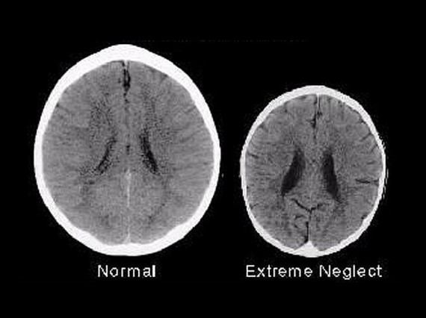
Notes:
LB
Atypical brain development if children are maltreated.
3 year old brains above show smaller cortex, reduced hippocampus (emotion and memory) – leads to problems with learning, behaviour and memory.
Lawson et al (2013) found the socio-economic status had an impact on brain cortical thickness, with lower SES having a smaller cortex.
)
Children remaining in parental care but under child protection had changes in the release of cortisol (the stress hormone) with these children having a blunted cortisol release in the morning but maintaining their waking cortisol level throughout the day rather than it dropping throughout the day as in typical development (Bernard et al, 2017).

Slide 4
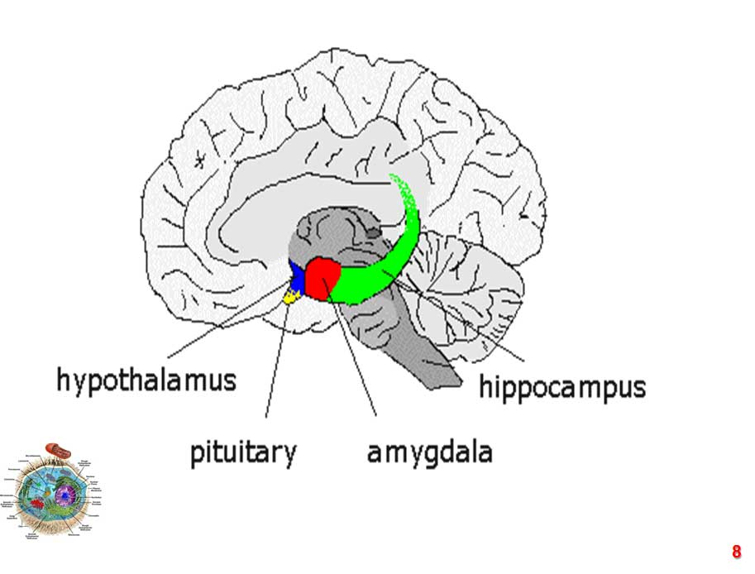
Notes:
LB
Children who suffer maltreatment also have atypical brain functionality in reward processing leading to addictive behaviour and mental health issues, and changes in the amygdala showing increased activation to threats (McCrory et al 2017).
Children who experienced traumatic treatment or events showed adaptations in the release of cortisol (the stress hormone). These children maintained their waking cortisol level throughout the day rather than it dropping throughout the day as in typical development (REFERENCE).
The emotional brain – HPA Axis
The emotional centre of the brain, housed in the limbic system, developed some millions of years earlier than the neocortex, the highest part of our brains, concerned with thinking, planning, memory, etc.
One of the main roles of a structure called the amygdala was to promote survival by alerting the organism to possible danger and triggering the physiological fight or flight response.
In essence, the amygdala was the limbic system's emotional alarm system, continually scanning the environment and interpreting each new stimulus in terms of whether it was safe or suspect. In colloquial terms, it was asking, "Can I approach this or not? Can I eat this or will this eat me? Will I fight (and win) or should I flee?"
The limbic system developed a rudimentary ability for memory and learning.
And it did that by a process that we term pattern matching, which still underlies our mental functioning today.
Several parts of the brain are key actors in the production of fear and anxiety. Using brain imaging technology and neurochemical techniques, scientists have discovered that the amygdala and the hippocampus play significant roles in most anxiety disorders.
The amygdala is an almond-shaped structure deep in the brain that is a communications hub between the parts of the brain that process incoming sensory signals and the parts that interpret these signals.
It can alert the rest of the brain that a threat is present and trigger a fear or anxiety response.
The emotional memories stored in the central part of the amygdala may play a role in anxiety disorders involving very distinct fears, such as fears of dogs, spiders, or flying.
The hippocampus is the part of the brain that encodes threatening events into memories.
In effect, the amygdala can have us reacting before the thinking brain has weighed up the evidence and planned an appropriate reaction.
As a result, some emotional reactions and consequent emotional memories can be formed without any conscious participation from the thinking brain at all.
When emotional arousal is high, the emotional brain is in the driving seat. It is the nature of the emotional brain to think only in survival-type choices — fight or flight; go for it or don't. While it is the job of the conscious mind to discriminate, fill in the detail and offer a more intelligent analysis of the patterns offered up to it by the emotional brain, the 'either/or' logic of the emotional brain is its more basic pattern which goes way back to earliest life forms and still forms the foundation on which much of our thinking and behaviour rests.
The degree to which the fight or flight reflex is activated is the degree to which our thinking becomes polarised — more black or more white. As psychologist Daniel Goleman describes it, the emotional brain 'hijacks' the neocortex and very quickly begins to blank out more subtle distinctions between stimuli. We can't be concerned with the finer detail when making a life saving decision.
In fact, all thoughts and perceptions are fuelled by, and therefore preceded by, emotion. We are not generally aware of this because it is often a subtle process but the fact that thoughts are carried aloft on emotion becomes clear when we examine strange exceptions to this rule.
Emotion, then, appears to be a precondition for thought

Slide 5
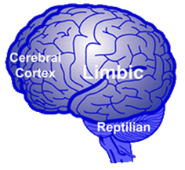
The part of the brain critical to fight, flight or freeze responses overdevelop compromising the part of the brain used for logic, empathy, cause and effect and reasoning. This affects the child’s ability to think, to retrieve information and manage behaviour. It diminishes the capacity of the frontal lobe associated with reasoning, planning, parts of speech, movement, emotions, and problem solving.
Notes:
LB
Need to be able to access the cold brain executive control to be able to utilise SE skills such as responsible decision making and self control. Use the muscle to build it therefore need to create an environment where anxiety is reduced and children can access the frontal cortex to repattern their brain and ultimately their behaviour.
Diamond and Lee (2011) found that interventions focused on EF, SE and Physical development was more effective intervention for EF development in 4-12yr olds.

Slide 6
INTERVENTION
Times are changing, our approaches need to follow suit – Rob Long
Reliable rules and practices help to regulate brain pathways ( Gerhardt 2004)
Notes:
LB

Slide 7
MASLOW’S HIERARCHY OF NEEDS
Notes:
ED
There are a number of behavioural and psychological theories that underpin our work. In terms of SEL outcomes a key focus is Maslow’s hierarchy of needs. How the stages work. – deficiency needs building from bottom up. Need to plug in gaps. Chn need to reach esteem level to be successful in school/life.
How the stages link to the 5 SEL competencies
ACTIVITY – thinking of the children you work with, and their behaviour – what do you think the predominant deficiency needs are that they are communicating with this behaviour? Which levels of Maslow’s hierarchy these needs relate to? Which area of SEL does this relate back to?

Slide 8
CASEL (2015)
Notes:
ED
Collaborative for Academic, Social, and Emotional Learning (CASEL) define SEL as comprising of 5 core competencies.
Links to Executive Function – attention, inhibition, flexibility, working memory – therefore the ability to decide on behaviour in order to reach goals.

Slide 9
BENEFITS OF SEL
SEL school based interventions significantly improved social and emotional skills, attitudes, behaviour and academic gains (Durlak et al, 2011).
Lower self control in childhood was found to predict poor health, lower wealth and increased likelihood of having committed crime by adulthood (Moffit et al, 2011).
In a review of 207 SEL programs there were suggested gains of 11% on test outcomes, 25% on social and emotional skills and a reduction of 10% in classroom behaviour issues (CASEL, 2009).
Notes:
ED

Slide 10
SEL INTERVENTION
CASEL (2015)
Notes:
ED
Therefore in order to reach the desired outcomes from SEL we need to be aware of the need for:
-specific teaching of skills
A universal approach which is taught through the curriculum not just as a stand alone curriculum area.
- Teachers are clear on best practice and this is implemented consistently.
Weare (2010) SEL intervention should be integrated across the school and the curriculum.
SEGWAY INTO UNIQUE’s WORK – Wilson and Lipsey (2007) found that the most effective programs for children at high risk were universal but with targeted support for those with specific needs.

Slide 11
MASLOW’S HIERARCHY OF NEEDS
Notes:
ED
There are a number of behavioural and psychological theories that underpin our work. In terms of SEL outcomes a key focus is Maslow’s hierarchy of needs. How the stages work. – deficiency needs building from bottom up. Need to plug in gaps. Chn need to reach esteem level to be successful in school/life.
How the stages link to the 5 SEL competencies
ACTIVITY – thinking of the children you work with, and their behaviour – what do you think the predominant deficiency needs are that they are communicating with this behaviour? Which levels of Maslow’s hierarchy these needs relate to? Which area of SEL does this relate back to?

Slide 12
CONTACT DETAILS
www.uniquebehaviour.co.uk
Lauren Bond
lb.unique@aol.co.uk
Notes:
ED

