Slide 1
Approaches to alcohol awareness with young people
PC Amy Fletcher

Slide 2
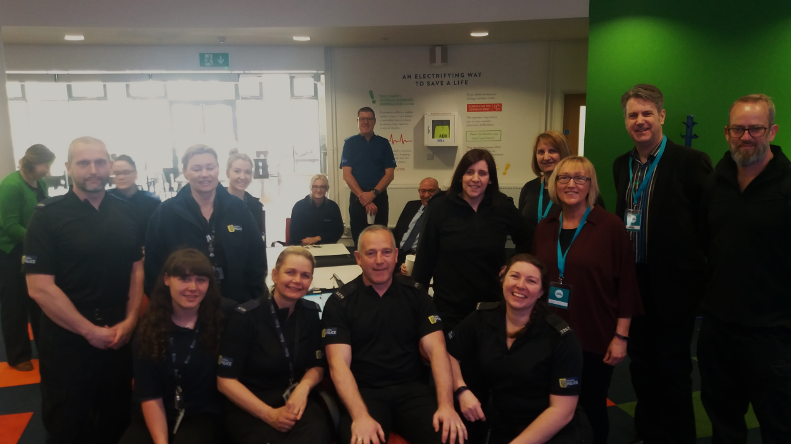

Slide 3
Barriers and Challenges

Slide 4
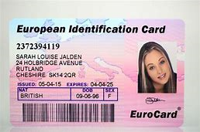
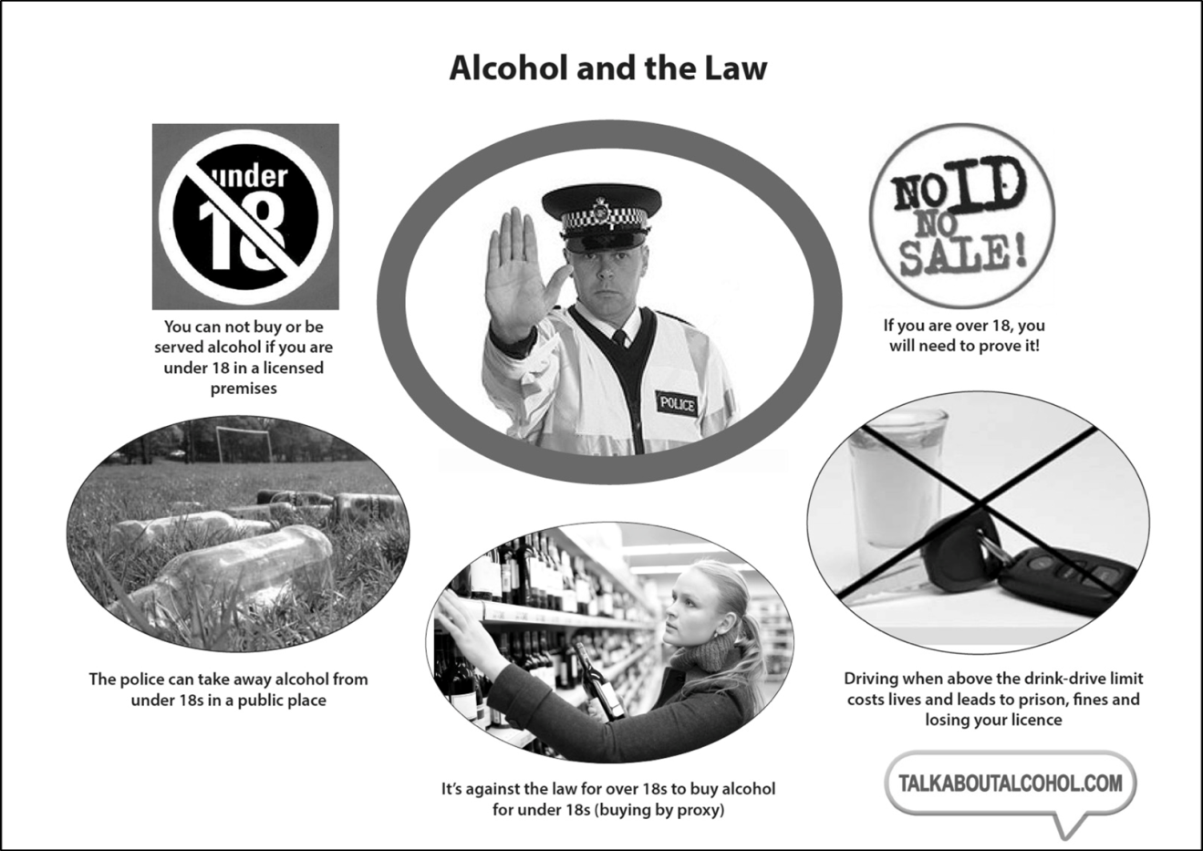
Examples of good practice

Slide 5
Fully evaluated teacher workbook and enhanced workbook with bespoke lessons for children with moderate learning difficulties
- 60 picture and story activity cards
DVD of 4 BAFTA award wining short films
30 lessons for varying ages and experience and abilities
6 bespoke lessons for children with moderate learning difficulties
National runner up for best secondary school resource 2017
A teacher workbook by topic freely available on line to download.
Information guidance for teenagers ‘Alcohol and you’
Information guidance for parents/carers
Talking to kids about alcohol

Slide 6
