Slide 1

Are you normal? (Mis)perceptions of alcohol and drug use in adolescents
Dr John McAlaney
Bournemouth University

Slide 2
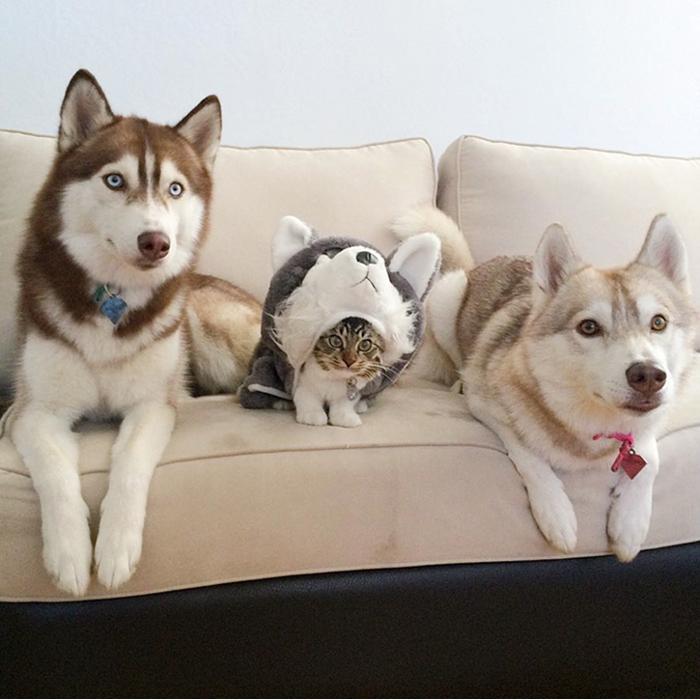

Slide 3

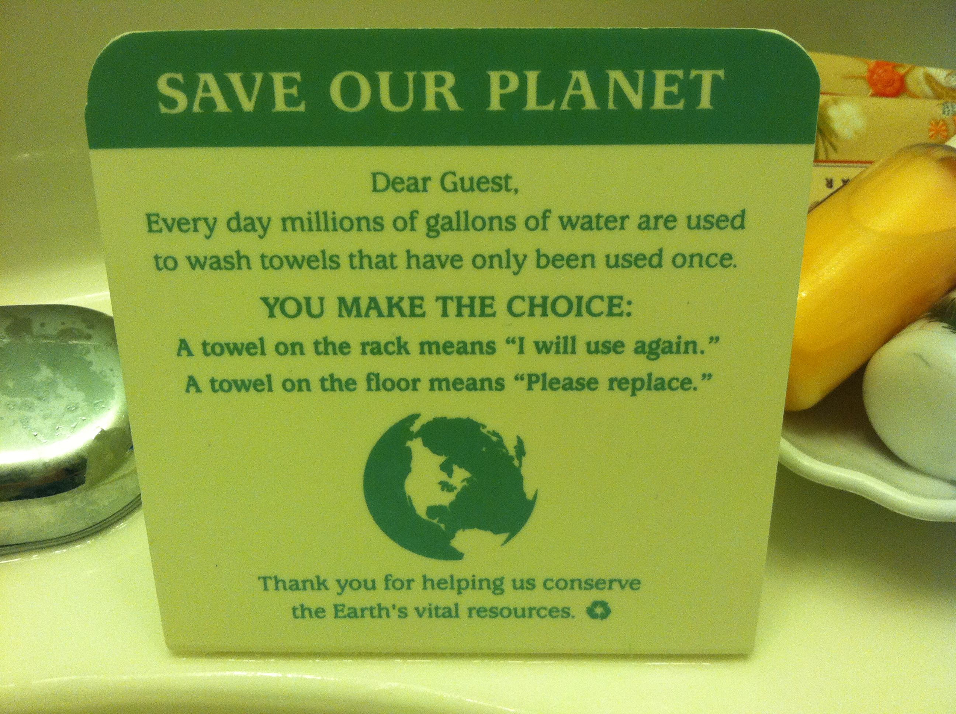

Slide 4
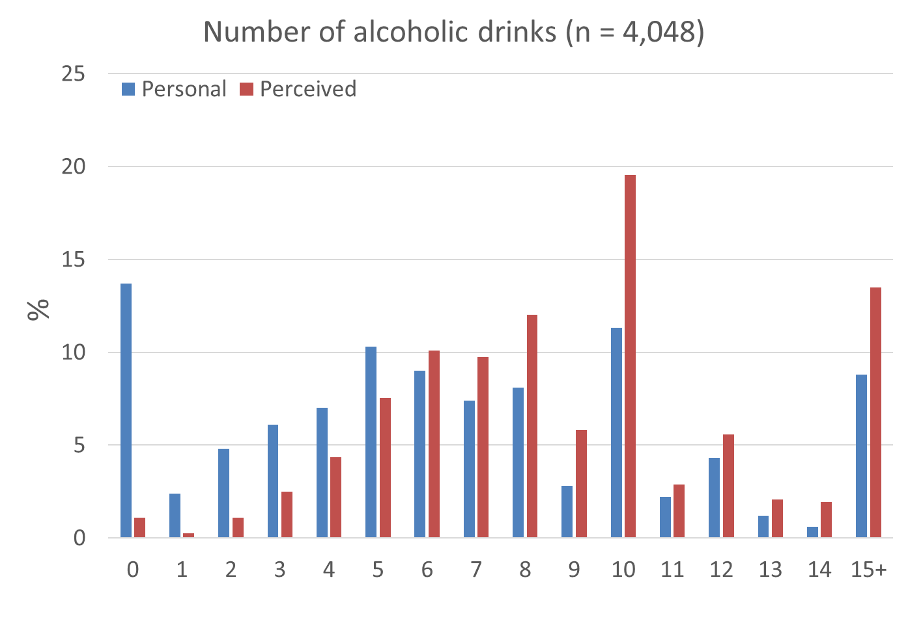

Slide 5
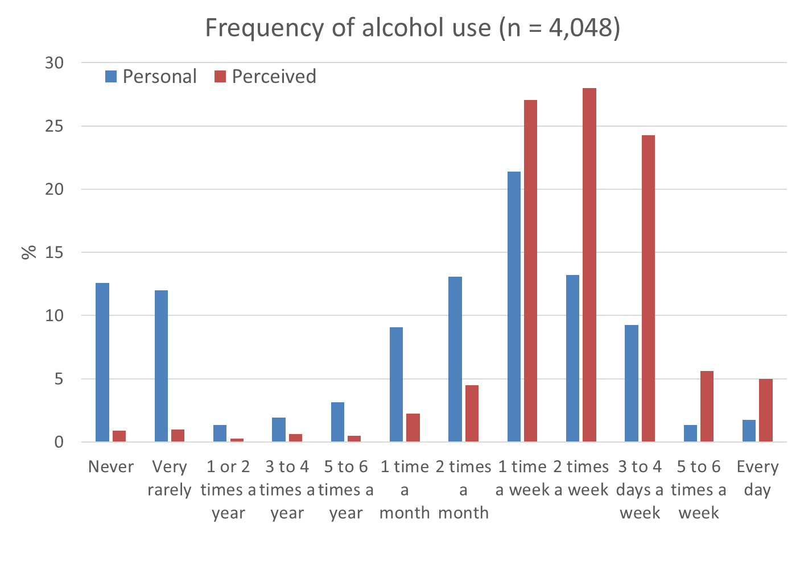

Slide 6
Predictors
 | Alcohol use frequency
 | B | β | t | p
Constant | .29 (-.77, 1.35 |  | .54 | 0.589
Perceived social norm | .31 (.25, .38) | .17 | 9.32 | < .001
Age | .04 (.0, .07) | .04 | 2.24 | 0.025
Gender (male/ female) | 0.00 (-.22, .22) | 0 | 0 | 0.998
Socialisation with peers | .45 (.34, .55) | .16 | 8.49 | < .001
Perceived typicality | .38 (.21, .55) | .08 | 4.40 | < .001
R² for alcohol frequency = .07

Slide 7
Predictors
 | Alcohol use quantity
 | B | β | t | P
Constant | -.98 (-2.1, 1.33) | .57 | -1.73 | .084
Perceived social norm | .69 (.66, .73) | .02 | 36.12 | < .001
Age | -.01 (-.44, .03) | .02 | -.37 | .713
Gender (male/ female) | -.67 (-.94, -.39) | .14 | -4.85 | < .001
Socialisation with peers | .46 (.33, .58) | .06 | 7.20 | < .001
Perceived typicality | .31 (.1, .51) | .10 | 2.96 | < .001
R² for alcohol quantity = .34

Slide 8
MEDIA
Third of Brits binge drink once a week… a quarter of over 45s drink EVERY day’ – The Sun, UK
‘Teens in grip of grog’ – The Herald Sun, Australia
‘Danish teenagers drink three times more than Russians’ – Danish news website

Slide 10
Additional Causes of misperception
Pluralistic ignorance
False consensus
Memory biases
Group dynamics

Slide 11
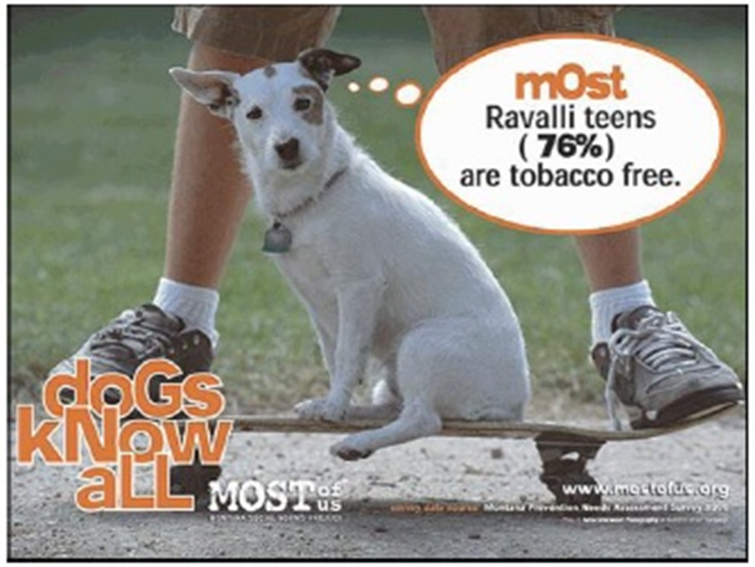
Using social norms

Slide 12
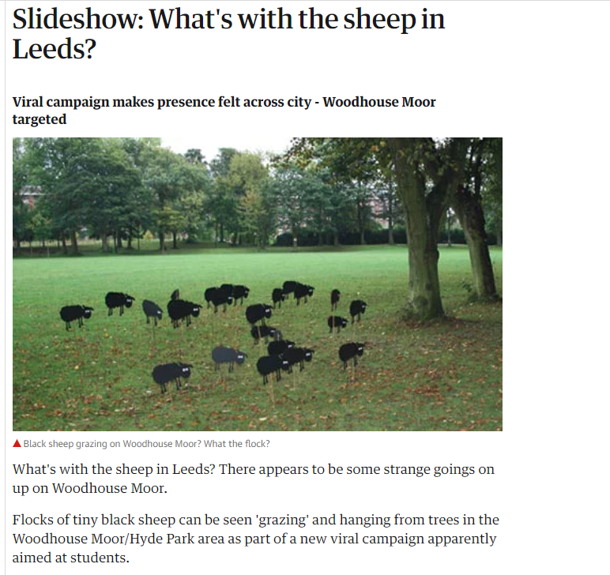
Using social norms

Slide 13
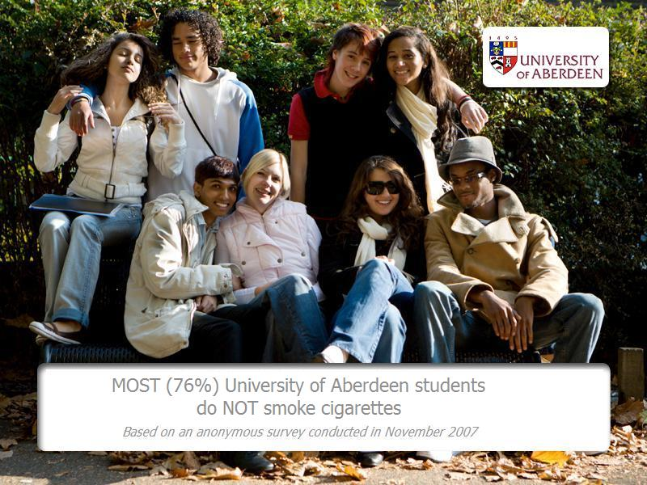

Slide 14
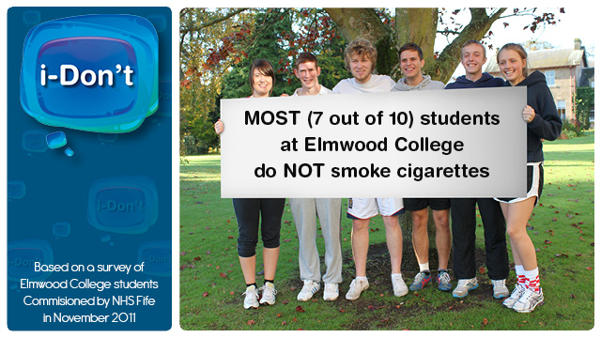

Slide 15
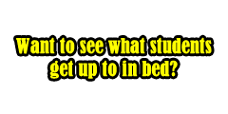
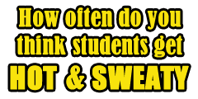
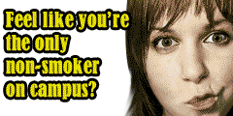
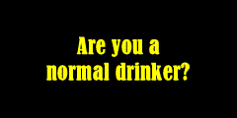
Sexual Health
Exercise
Smoking
Alcohol

Slide 16
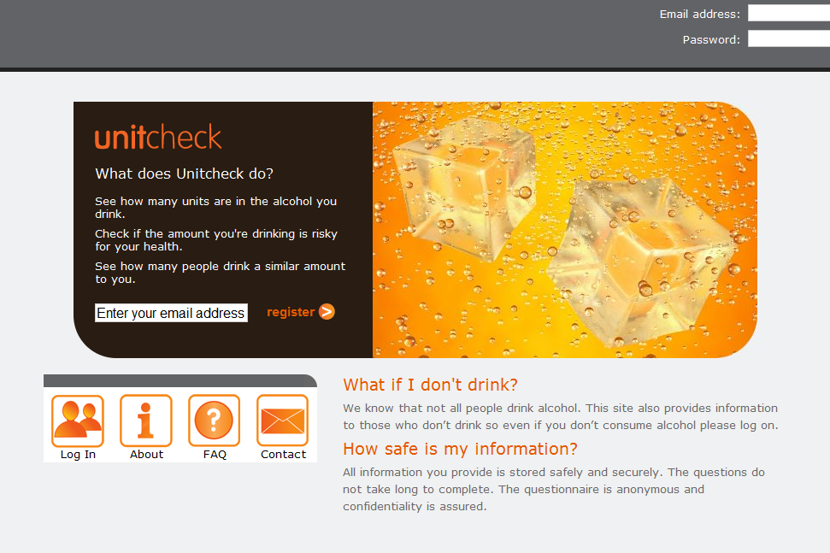
Personalised feedback
Bewick, B. M., K. Trusler, B. Mulhern, M. Barkham and A. J. Hill (2008). "The feasibility and effectiveness of a web-based personalised feedback and social norms alcohol intervention in UK university students: A randomised control trial." Addictive Behaviors 33(9): 1192-1198.

Slide 17
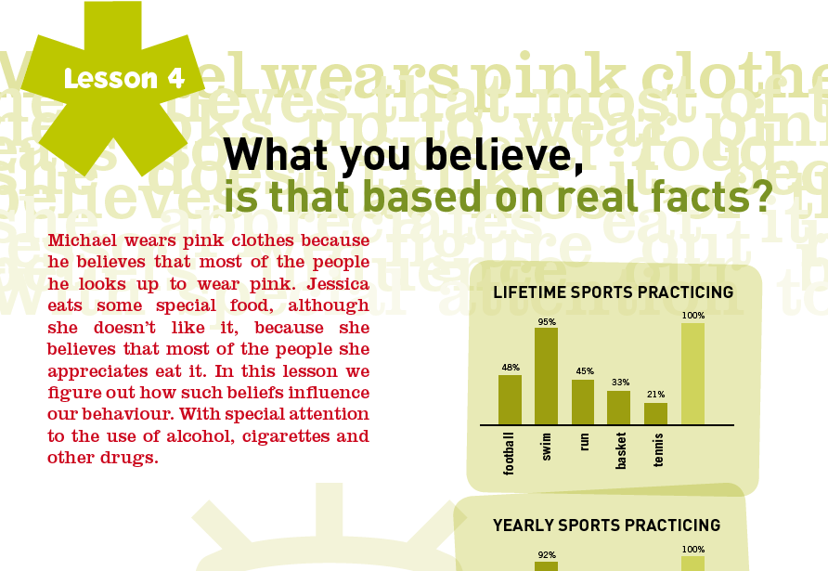
School activities

Slide 18
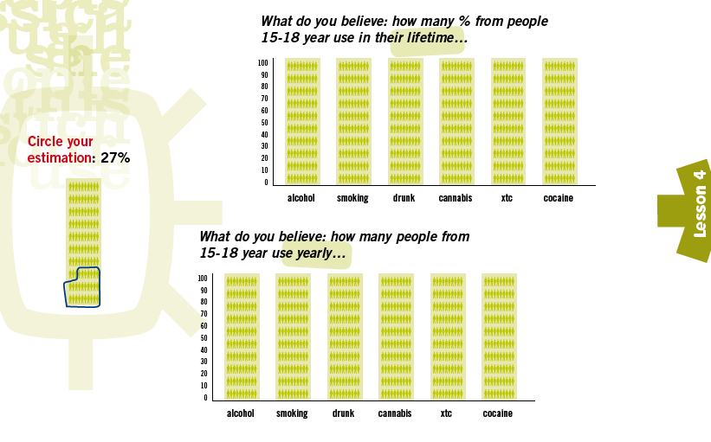
School activities
Full report available at www.eudap.net

Slide 19




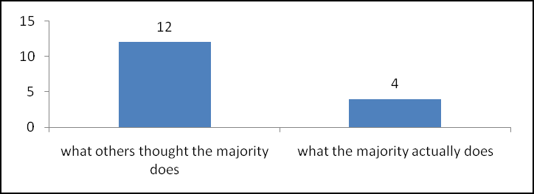
Did you know?
… 95% Bradford University students have never used amphetamines
Alcohol
How many… ?
You said
‘I have 5 drinks on a typical night’
‘I think the majority of male University of Bradford students have 10 drinks on a typical night’
Alcohol
Tobacco
Cannabis
What about drinking peak? Click here!
Poly substance use
What about getting drunk? Click here!

Slide 20
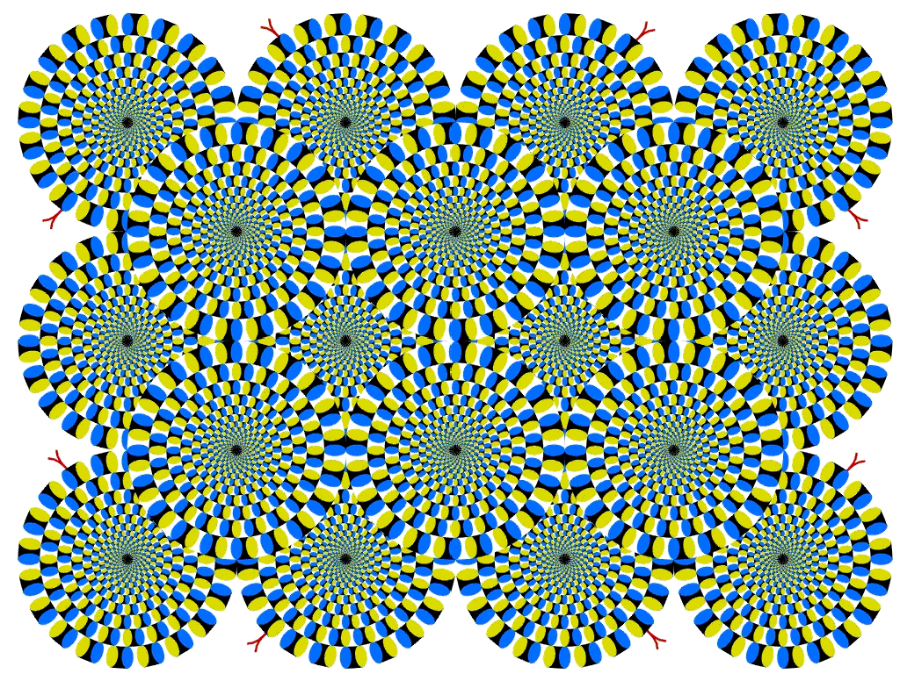

Slide 21
Efficacy and challenges
Some criticisms of the social norms approach to reducing alcohol harm (e.g. Foxcroft et al. 2015)
  Low number of randomised control trials
  Variability of methodological rigour
  Lack of clarity on how the social norms campaign was implemented
However the finding that individuals, especially young adults, do overestimate alcohol use in their peers is strong and consistent

Slide 22
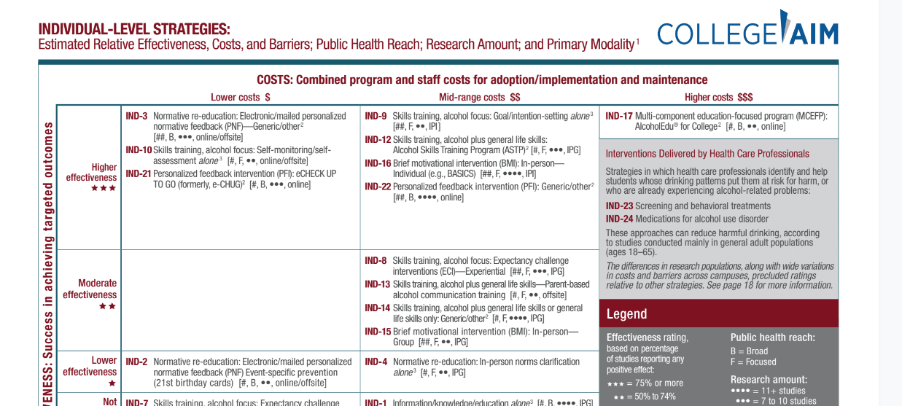
National Institute on alcohol abuse and alcoholism recent guidance

Slide 23
Reactions to the social norms approach
“…we need to use the strengths of the social norms approach, together with the strengths of other experiences, to overcome huge behavioural challenges” Robert Madelin, EU Director General for Health and Consumer Protection
“I am convinced that it is a relatively simple and cost-effective means of achieving behavioural change. Most importantly, it is positive rather than negative. It does not condemn, preach or use scare tactics, and it works!”
Dr Bill Wilson, Member of the Scottish Parliament

Slide 24
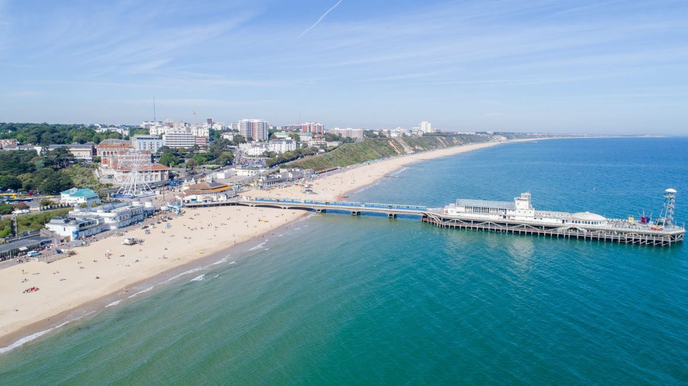
jmcalaney@bournemouth.ac.uk

