Slide 1

Trends in drug and alcohol use among young people and some connections
AET/Mentor Alcohol and Drugs Education Conference
Thursday 21 June 2018, Liverpool John Moores University
Evidence-based best practice in alcohol and drugs education: empowering young people to make healthy choices in the classroom and beyond
Dr David Regis, Schools Health Education Unit, Exeter
www.sheu.org.uk

Slide 2
Trends
Most measures of alcohol and drug use among young people show decline in prevalence & incidence over the last 10 years or so.
Longer data series show a rise to a mid-1990s peak, perhaps a wobble, then a decline since 2000)

Slide 3
Sources
Niblett, P (Ed.) (2017). Smoking, drinking and drug use among young people , England:2016
Health and Social Care Information Centre
Fuller, E (Ed.) (2015). Smoking, drinking and drug use among young people in England in 2014
Health and Social Care Information Centre
Balding & Regis (2018). Young People into 2018. Exeter: SHEU

Slide 4
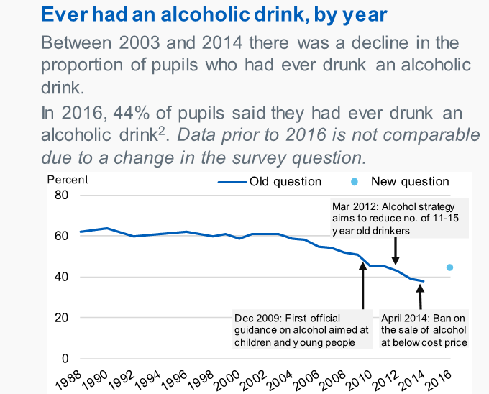
Ever drank alcohol 1988-2016

Slide 5
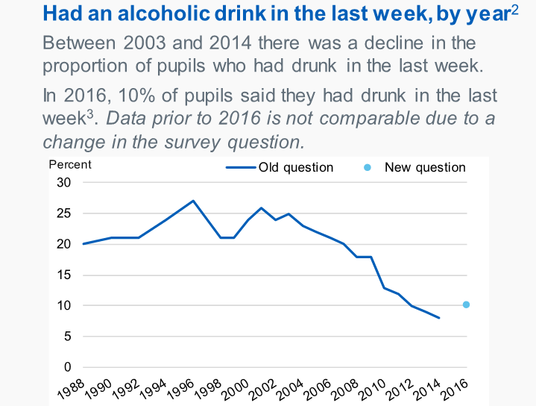
Drank last week 1988-2016

Slide 6
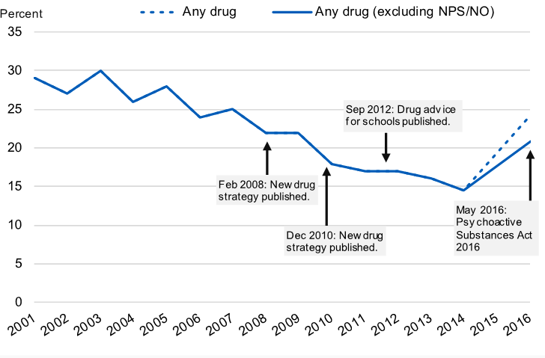
Drugs ever 2001-2016

Slide 7
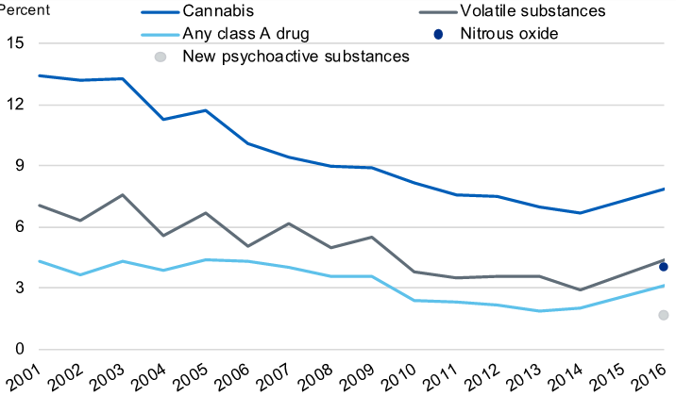
Taken drugs last year 2001-2016

Slide 8
Context
I’d like to credit the skill and dedication of PSHE teachers over the decades. However…
There are similar declines:
in other behaviours in this age group (smoking, pregnancy)
in other age groups (drugs, crime)
even in other countries
(the ‘crime drop’)

Slide 9
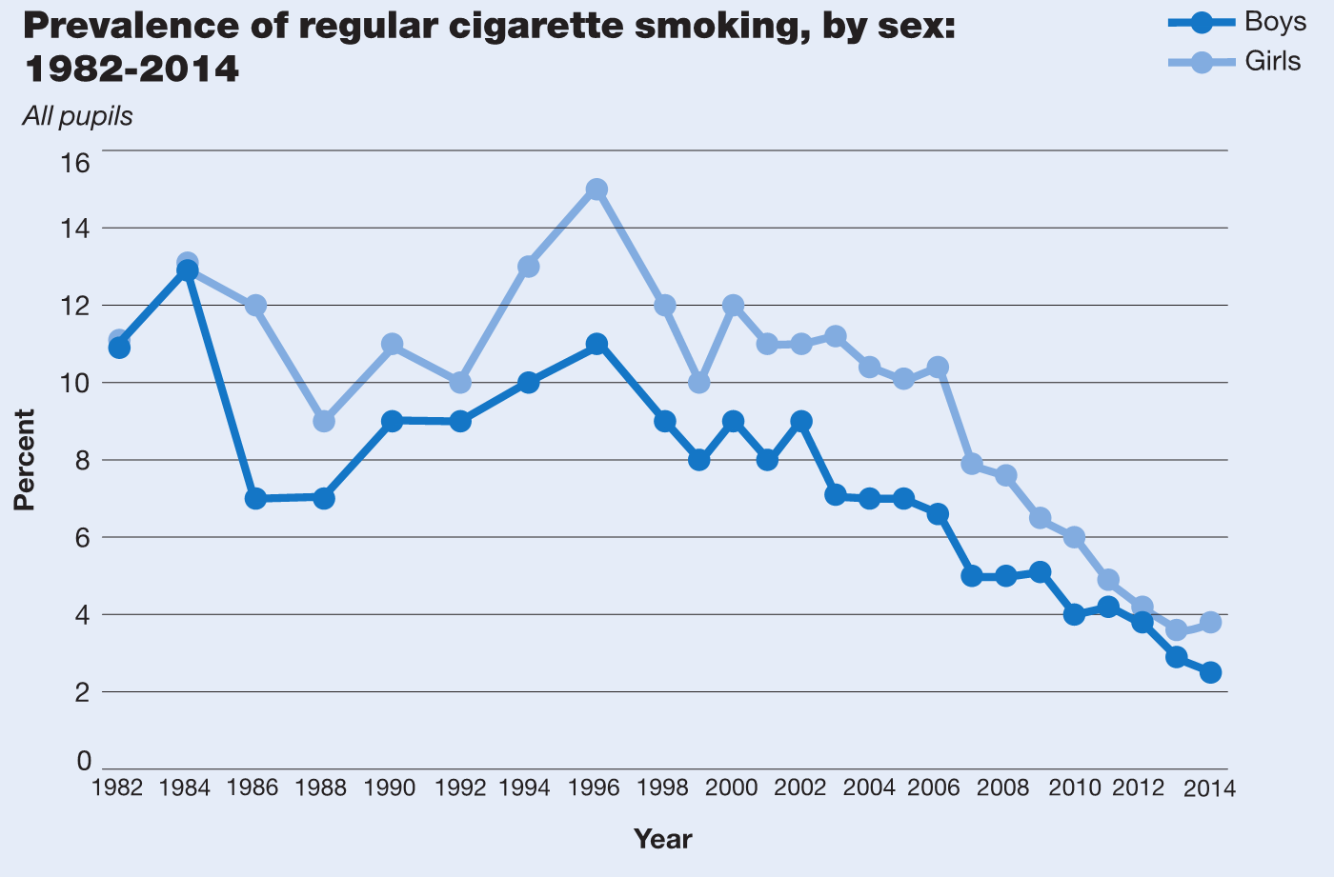
Regular Smoking 1982-2014

Slide 10
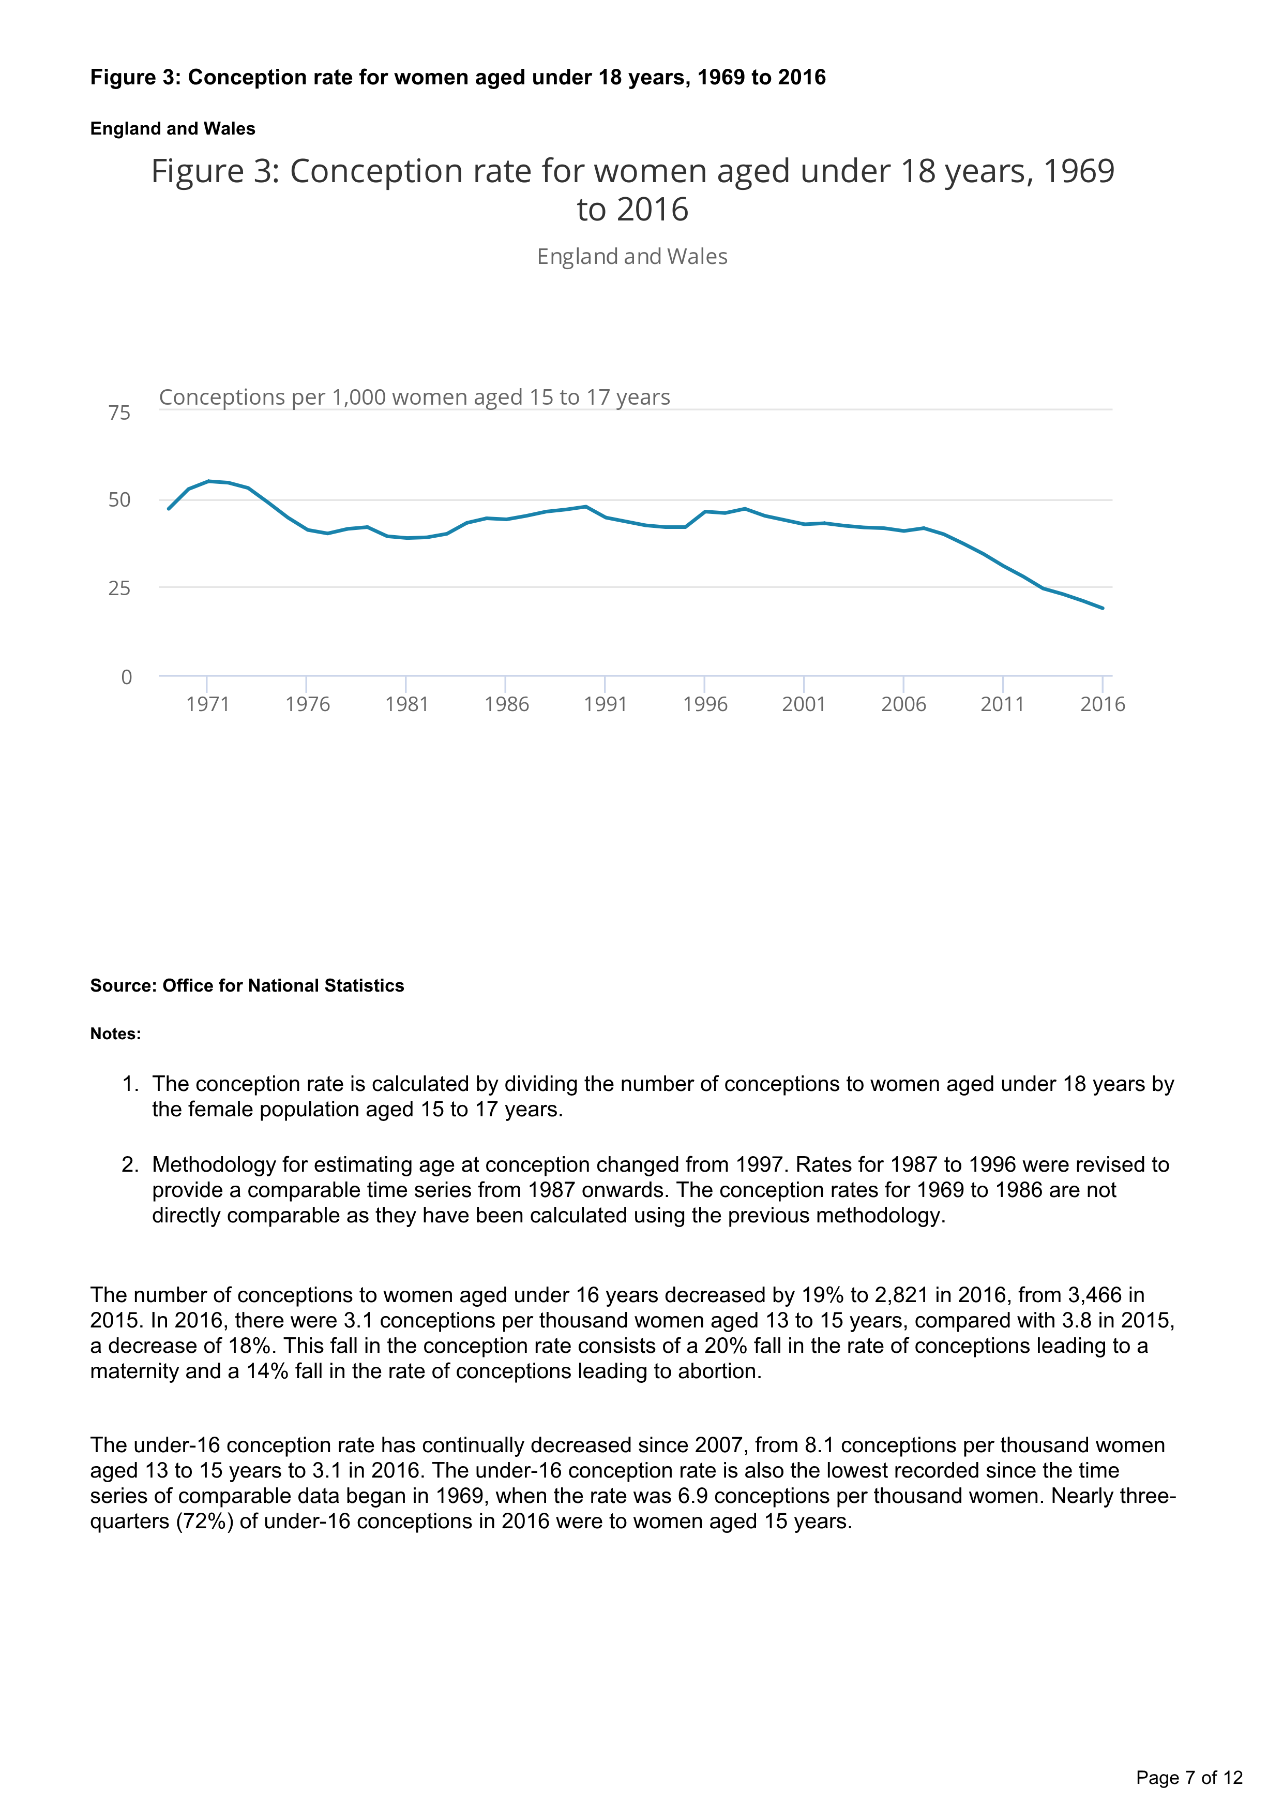
Conceptions 1969-2014
Under 18 conception rate, 1969 to 2014 England and Wales
Source: Office for National Statistics

Slide 11
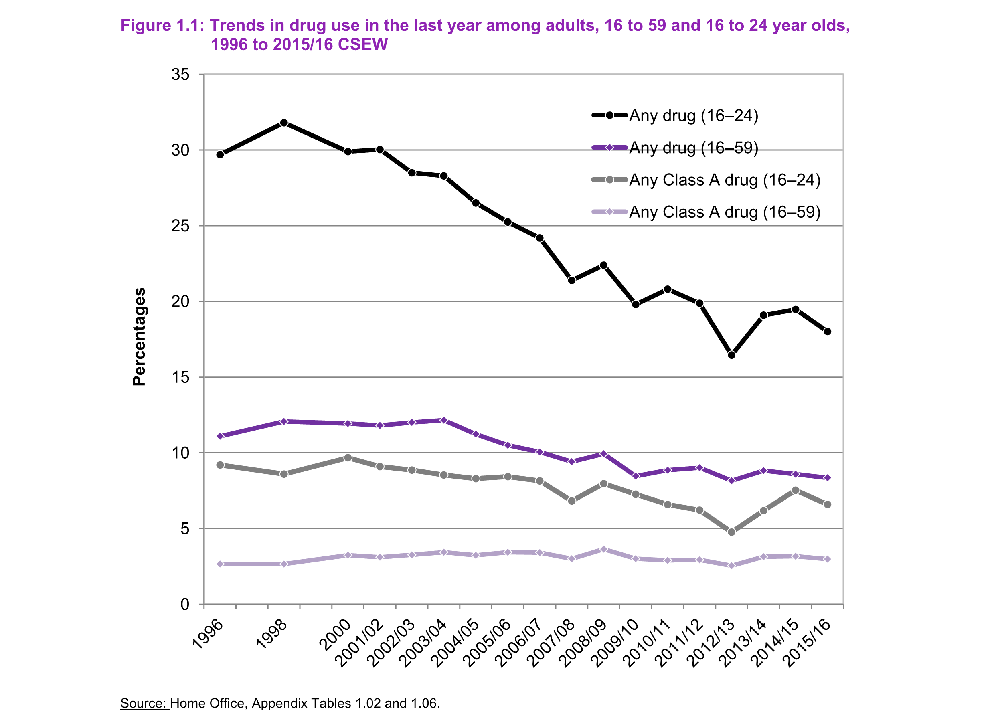
Drug use 1996-2016, 16-59y & 16-24y

Slide 12
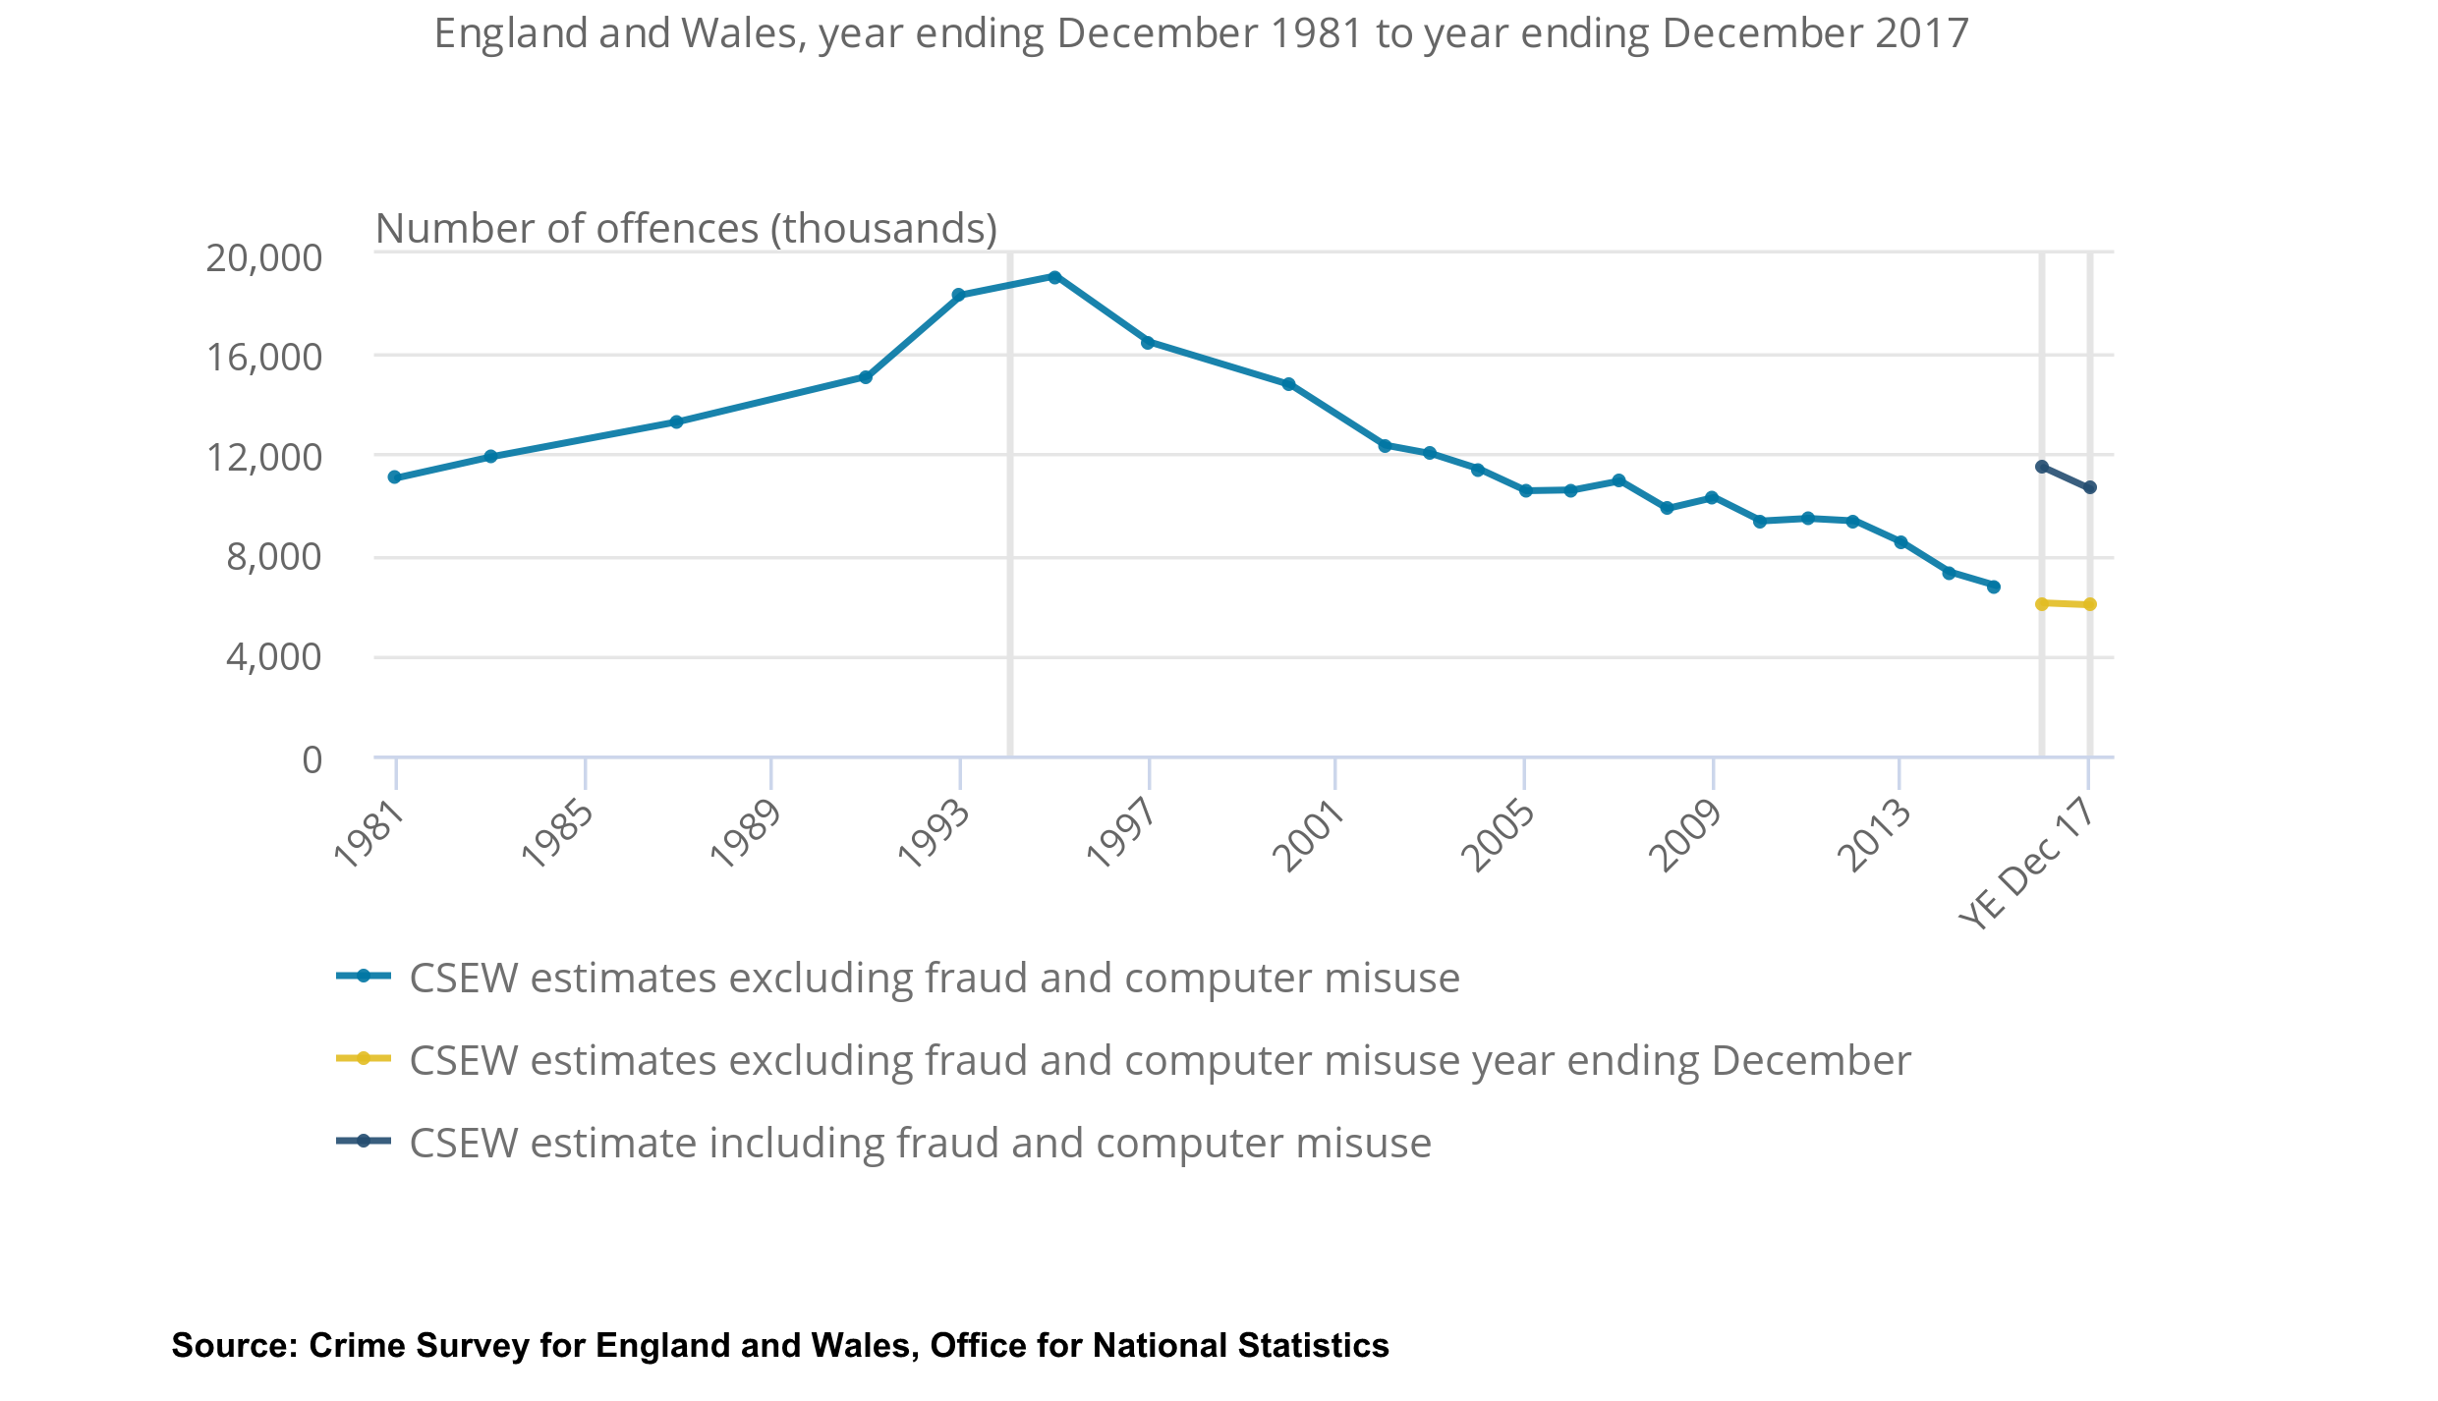
Crime survey & recorded crime E&W 1981-2017

Slide 13

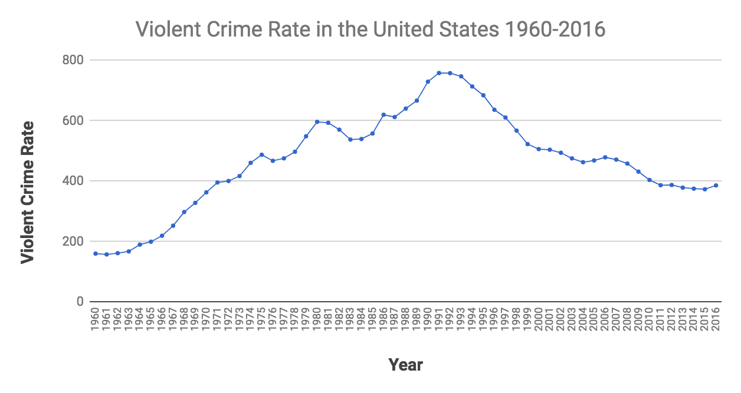
Crime USA 1960-2016
Source: Politifact/FBI

Slide 14
SHEU databanks
SHEU has data going back many years arising from schools’ service (now largely funded by local authorities)
SHEU data sets are broad and deep (if rather scruffy), and show similar levels and patterns of change seen in other studies (a rise to a mid-1990s peak, perhaps a wobble, then decline since 2000)
Alcohol and drug use can be shown in most recent data set to be linked to risk & protective factors seen in US research (e.g. self-esteem)
Alcohol and drug use can be shown in the most recent data set to be linked to many other desirable and undesirable behaviours (=lifestyle?)
Alcohol and drug use can be shown in the most recent data set to be higher in vulnerable groups (especially LGB students)
Looking back over time, there are changes in some protective factors (self-esteem among older females is not as high as previously)
Looking back over time, the relationship between self-esteem and alcohol use has reversed in direction – currently high self-esteem linked with lower likelihood of alcohol use in last week in Year 10 males

Slide 15
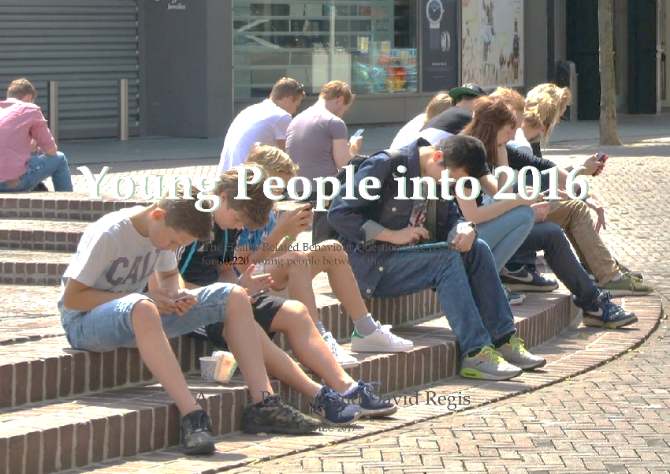
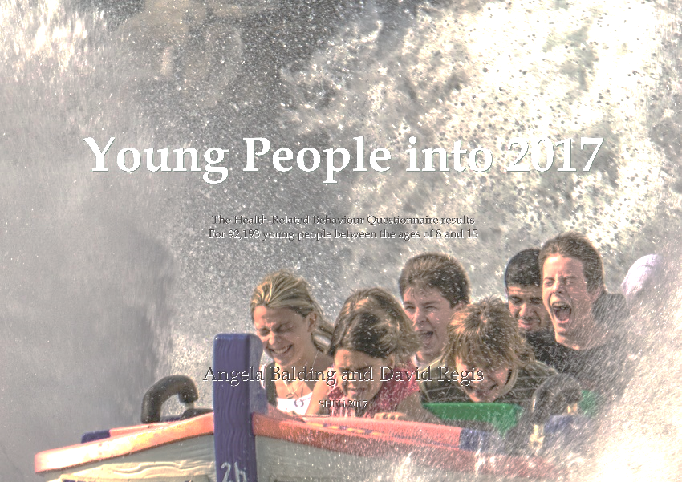
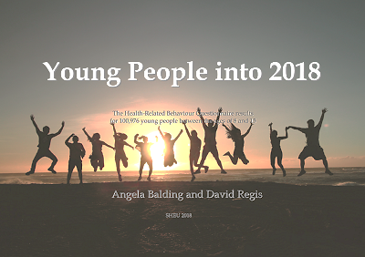
SHEU reports

Slide 16

From data to debate...
! ? * !! ??
$$!

Slide 17
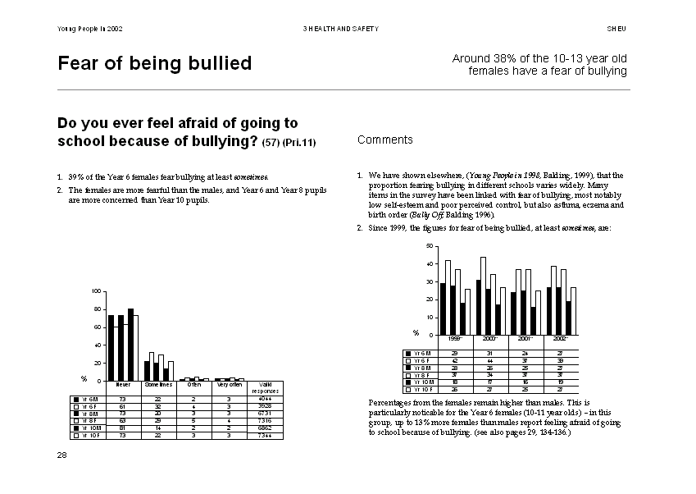
Young People into...
Not a stratified sample…
ANNUAL DATABANK
Selected local authorities
A | C | D | G | J | K | L | P | R | T
Selected schools in a local authority
J1 | J2 | J4 | J5 | J6 | J9 | J10 | J15 | J16 | J18

Slide 18
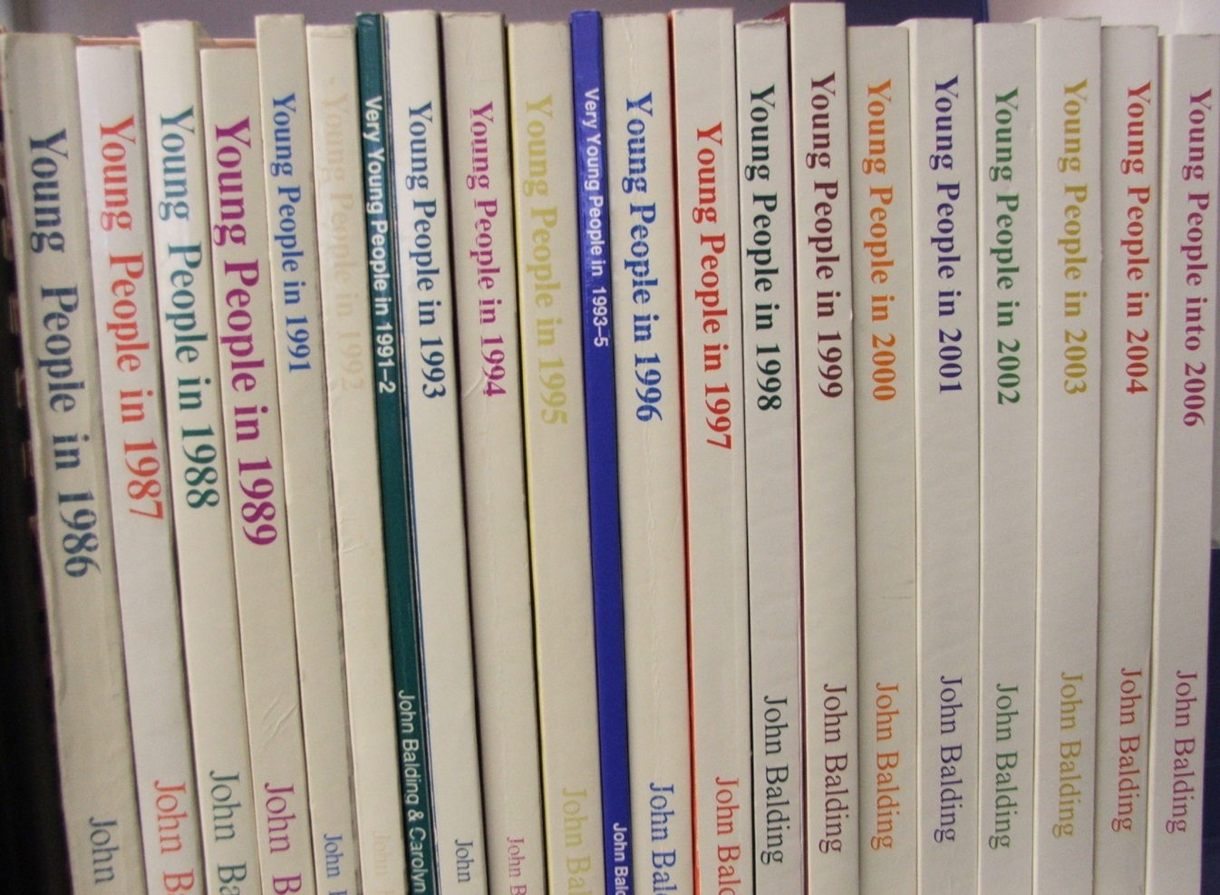
SHEU databanks
(cannabis use 1987-2017)
… so, an opportunity sample, but showing same patterns as
stratified samples
SHEU, Exeter, 2018

Slide 19
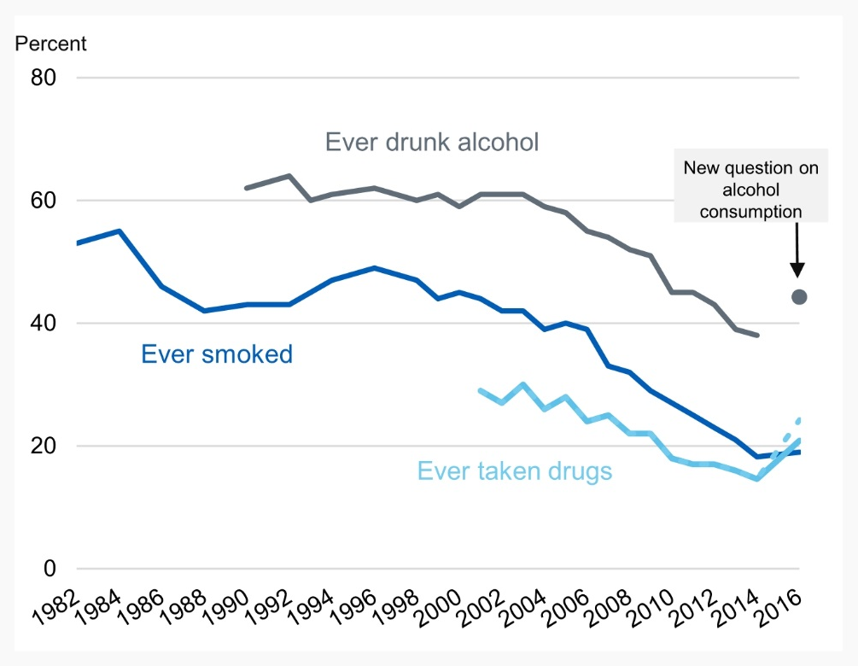
Trends ONS /SHEU
Ever smoked
Ever taken cannabis

Slide 20
SHEU samples vs Edubase

Slide 21
Vulnerable groups (one LA)
SHEU, Exeter, 2016
p < 0.05
p < 0.01

Slide 22
Protective factors – individual
Percentage of Y10 students drinking in the last week
SHEU, Exeter, 2014

Slide 23
Trends in relationships between factors
Drinking last week and self-esteem (Y10M)
SHEU, Exeter

Slide 24
Trends in protective factors
Percentages in lowest brackets of self-esteem scores 1991-2017
SHEU, Exeter, 2018

Slide 25
Starters for 10…
The figures are looking better
But young people’s lives may not be
Zoom out and you can see
  Connections across lifestyle
  Some broad changes at work
Zoom in and you can see some particular challenges
  Vulnerable groups e.g. LGB

Slide 26
(End)

