Slide 1

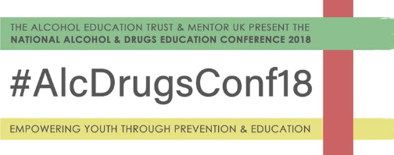
National Alcohol & Drugs Education Conference 2018
Liverpool John Moores University
21st June 2018
ljmu.ac.uk

Slide 2
Welcome to Liverpool
A city of contrasts

Slide 3
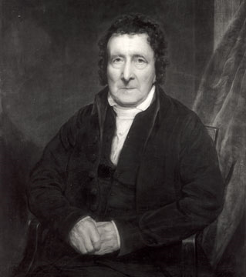
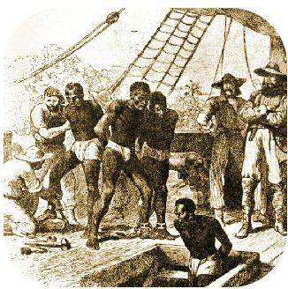
Notes:
Liverpool was a major slaving port and its ships and merchants dominated the transatlantic slave trade in the second half of the 18th century. The town and its inhabitants derived great civic and personal wealth from the trade which laid the foundations for the port's future growth.
The growth of the trade was slow but solid. By the 1730s about 15 ships a year were leaving for Africa and this grew to about 50 a year in the 1750s, rising to just over a 100 in each of the early years of the 1770s. Numbers declined during the American War of Independence (1775-83), but rose to a new peak of 120-130 ships annually in the two decades preceding the abolition of the trade in 1807. Probably three-quarters of all European slaving ships at this period left from Liverpool. Overall, Liverpool ships transported half of the 3 million Africans carried across the Atlantic by British slavers

Slide 4
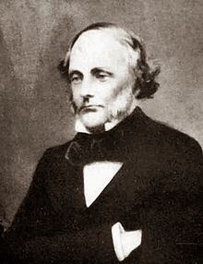


Slide 5
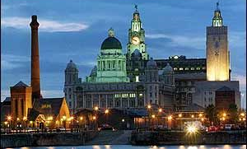

Liverpool - Now

Slide 6
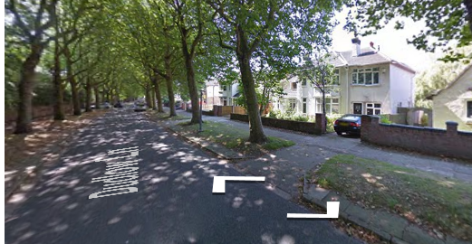
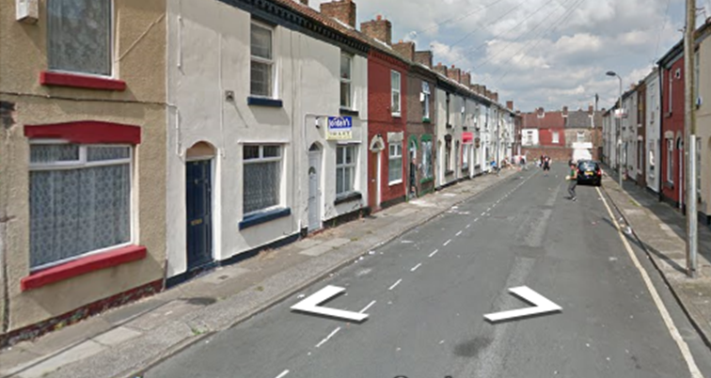

Slide 7
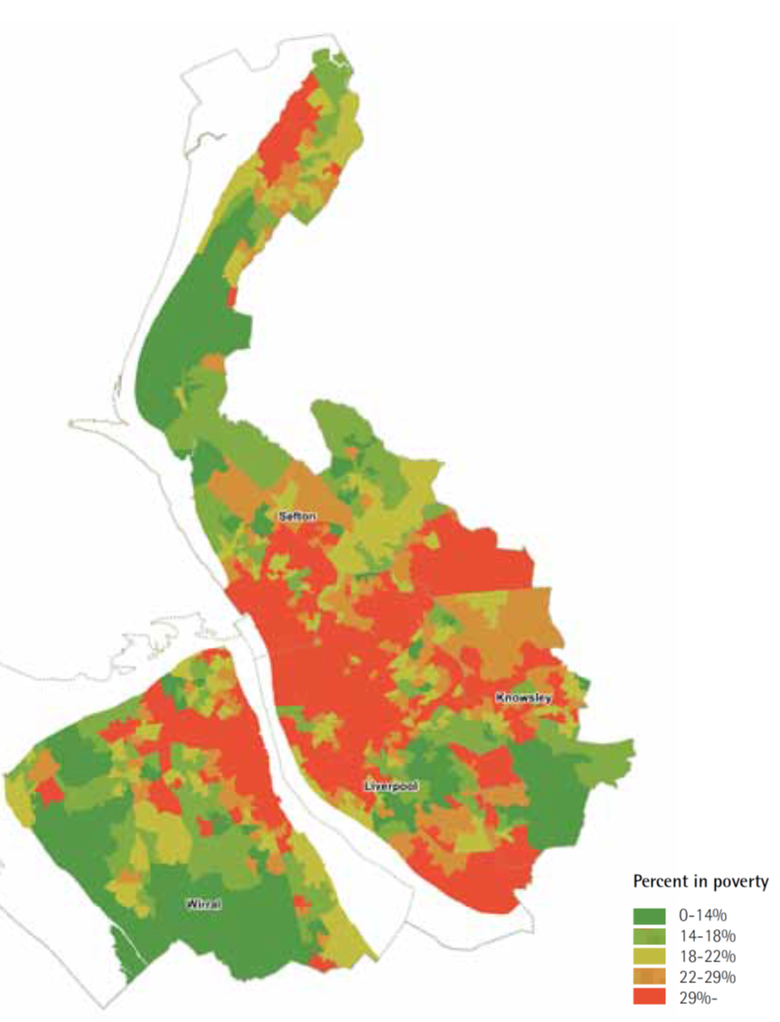
Percentage of Liverpool population in poverty
Hunter P (2014) Poverty in suburbia: a smith institute study into the growth of poverty in the suburbs of England and Wales

Slide 8


Slide 9
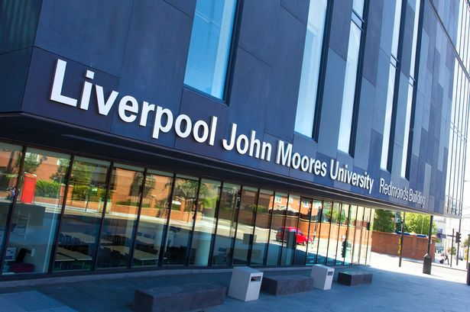

Slide 10
Liverpool John Moores University
‘To be a pioneering modern civic university, delivering solutions to the challenges of the 21st Century’

Slide 11
The Modern Civic University
A university with strong roots in the city, that enriches its social and cultural life.
A university where innovation and enterprise drive economic growth in partnership with business and industry.
A university that acts as a catalyst for positive social change, and enhances the life, aspirations and prospects within our communities.
A university which has global reach and impact, and acts as a gateway for overseas engagement and investment.
A university which influences policy and debate through its links with professional and public sector bodies.

Slide 12
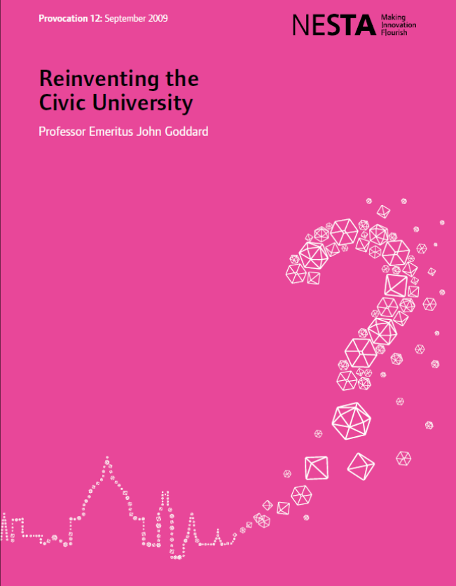
“Civic engagement should be on a par with teaching and research as a university mission”
“…an institution-wide strategy for civic engagement, a strategy that reaches across teaching and research rather than being boxed off as a third stream of activity”.
“Doing the right thing”
“Civic engagement should be part of public health teaching and research”

Slide 13
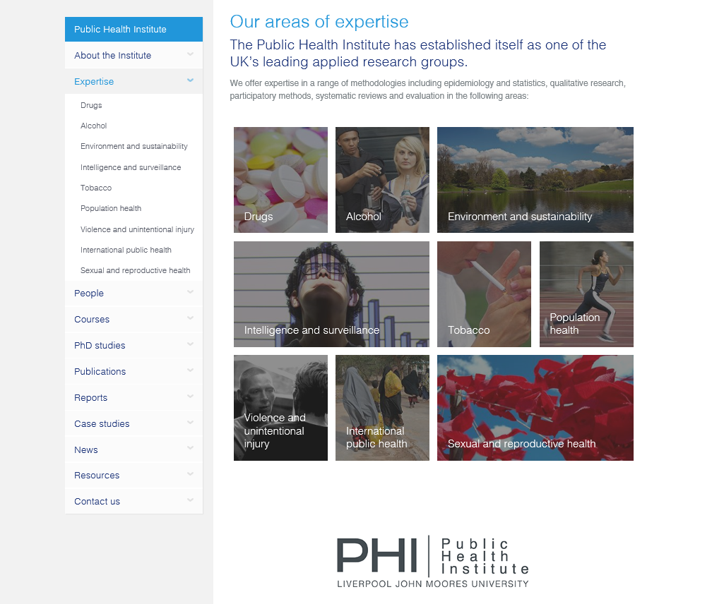

Slide 14
‘To be a pioneering modern civic university, delivering solutions to the challenges of the 21st Century’
Jim McVeigh
Director
Public Health Institute
Liverpool John Moores University
(+44)151 231 4512
j.mcveigh@ljmu.ac.uk

