Slide 1
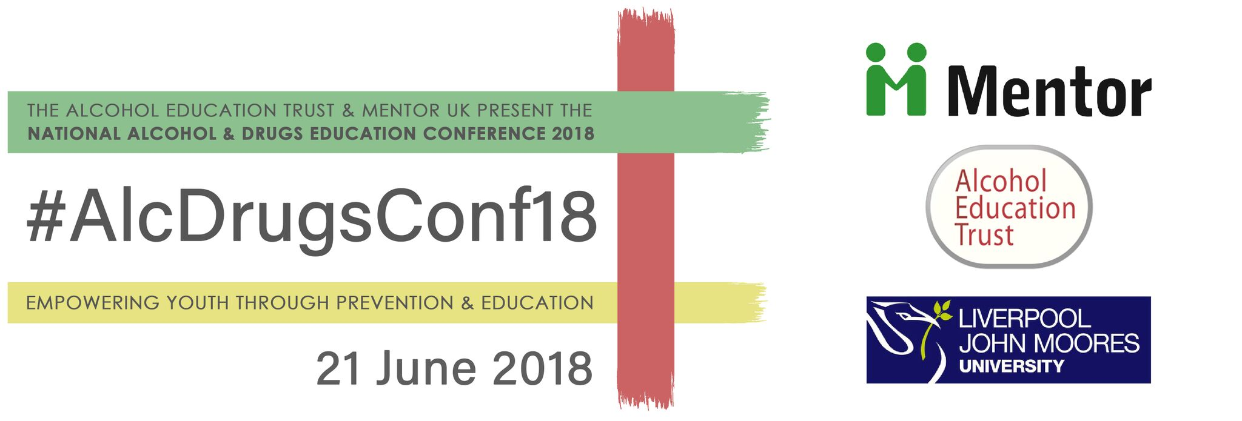
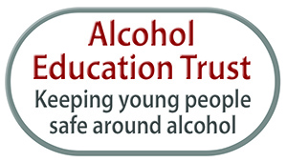
National Alcohol & Drugs Education Conference 2018 Evidence based practice in alcohol and drugs education Empowering young people to make healthy choices
Michael O’Toole
Twitter: @otoole_Michael
Evidence-based practice in prevention
Liverpool John Moores University

Slide 2
To promote the health and well being of children and young people and prevent alcohol and drug misuse.

Slide 3
What evidence shows....
System of prevention
Internal & external factors
Life skills build resilience to risks
Positive social norms
Age appropriate & early intervention
Critical role of schools & parents
Notes:
The teenage brain is still developing and specially vulnerable to substance use. The earlier substance use starts, the bigger the risk of it leading to substance use disorder.

Slide 4
Evidence-based practice in prevention
What does work?
Approaches based on ‘social influences’ are effective at changing young people’s behaviour
Programmes based on life-skills approaches reduce alcohol, tobacco and cannabis use
Improving a range of personal and social skills
Delivered through a series of structured sessions, interactive sessions over multiple years
Delivered by trained teachers or facilitators

Slide 5
Evidence-based practice in prevention
What doesn’t work?
Emphasising harms (scare techniques)
Knowledge-based education (relying on information alone)
One-off sessions
Passive approaches (posters, leaflets, TV adverts)
Use of ex drug users and/or police officers
Focusing only on building of self-esteem and on emotional education

Slide 6
Life skills education
“a holistic approach to the development of values, skills and knowledge in the learner, which assists young people to protect themselves and others
in a range of risk situations.”
- UNICEF, 2009

Slide 7
Lifeskills
Critical thinking
Decision-making
Effective communication
Relationship skills
Self-awareness
Empathy
Coping with emotions

Slide 8
A model of good drug education
Needs-led and age-appropriate;
Interactive learning;
Develop positive health values;
Developing personal and social skills;
Challenging misperceptions about the prevalence and acceptability of drug use among peers.

Slide 9
ADEPIS
ADEPIS is publicly acknowledged as the leading source of evidence-based resources for alcohol and drug education and prevention for schools.
www.mentor-adepis.org
Notes:
The Alcohol and Drug Education and Prevention Information Service is a platform for sharing information and resources aimed at schools and practitioners working in drug and alcohol prevention.
The resources we have already produced draw on eight years of work with the Drug Education Forum, which supported local authorities and schools to implement best practice in drug education.
In April 2015, Mentor was granted additional joint government funding to manage the Centre for Analysis of Youth Transitions (CAYT) and integrate its repository of evidence-based impact studies into Mentor-ADEPIS.

Slide 10
Education is not a tool for development....It is the foundation for our future. It is empowerment to make choices and emboldens the youth to chase their dreams.
Nita Ambani
Notes:
The teenage brain is still developing and specially vulnerable to substance use. The earlier substance use starts, the bigger the risk of it leading to substance use disorder.

Slide 11
Michael.otoole@mentoruk.org
@otoole_Michael
www.mentoruk.org.uk

